Slide 1
USERS
Role-based workspaces
Applicant
Submit application, upload documents, pay, download QR.
PT(IKL)
Returned cases, letters, bills, receipts, e-license.
KU(IKL)
Initial screening and final technical checking.
IKL Technical
Site visit, fee/deposit calculation, recommendation.
BLG/GPM/MNE/IMT/LNP/ENG
Specialist technical reviews and remarks.
KB(LES)
Verification and unit support before approval.
TP(RES)/PGH
Final approval recommendation and management decision.
MPHLG
External review or approval stage where required.
DBKU Advertisement License Application System
03

Slide 2
OPERATIONAL FLOW
End-to-end license workflow
1
2
3
4
Applicant submits form
KU(IKL) screens
Technical review
KU(IKL) final check
5
6
7
8
KB(LES) verifies
TP(RES)/PGH approves
PT(IKL) bill and receipt
QR e-license issued
DBKU Advertisement License Application System
04

Slide 3
TECHNOLOGY STACK
Framework and technical architecture
Frontend
Backend
Runtime
React 19 + Vite 8
Django 5.2 + DRF 3.17
Gunicorn and Docker
Single-page web application with fast build tooling.
REST API layer for applications, accounts, and notifications.
Backend can run as a production WSGI service.
React Router
SimpleJWT
Nginx frontend
Role-based navigation for applicant, admin, and supervisor journeys.
Bearer-token authentication with rotating refresh tokens.
Frontend includes nginx config for static delivery.
UI and document tools
PostgreSQL-ready
CORS configured
CKEditor, qrcode.react, jsPDF/html2canvas, Mapbox/MapLibre.
psycopg2-binary dependency, media/static handling with WhiteNoise.
Allowed origins include localhost and fastrack.sapotlokal.my.
Architecture pattern: React client -> authenticated REST API -> Django domain modules -> database, media, and notification services.
DBKU Advertisement License Application System
10

Slide 4
SECURITY CONTROLS
Rate limiting as backend traffic rules
If a user, browser, or IP sends too many requests, Django temporarily blocks the request with 429 Too Many Requests.
Normal API traffic
Login protection
Anonymous API: 120/min
Public pages, register, and login-page API calls before the user signs in.
Login per IP: 120/min
Blocks obvious login flooding from one internet address.
Logged-in API: 1000/min
High enough for normal staff/applicant work, but still stops loops or spam clicks.
Login username+IP: 10/min
Example: someone keeps guessing the password for ptikl from the same computer.
Account recovery
File upload protection
Register: 20/hour
Helps stop fake account creation from one IP.
Upload: 60/hour
A logged-in user can upload files up to 60 times per hour.
Reset request: 5/hour
Stops email or WhatsApp OTP spam.
Why it matters
Protects storage and server resources from repeated upload spam.
OTP verify: 30/hour
Limits repeated OTP guessing attempts.
Reset confirm: 10/hour
Limits final password changes.
For ALiS, the defaults are balanced: strict on login/reset, generous for normal logged-in usage.
DBKU Advertisement License Application System
11

Slide 5
These are backend “traffic rules”. If a user/browser/IP sends too many requests, Django blocks temporarily with `429 Too Many Requests`.
`Normal anonymous API: 120/min`
For users not logged in. Example: public pages, register, login page API calls. One IP can make up to 120 anonymous requests per minute.
`Logged-in user API: 1000/min`
For users already logged in. This is high so normal staff/applicant work will not be disturbed, but it still protects the backend from accidental loops or spam clicks.
`Login per IP: 120/min`
One internet address can only try login 120 times per minute total. This blocks obvious login flooding from one place.
`Login per username+IP: 10/min`
Same username from same IP can only try login 10 times per minute. This is more important for brute-force protection. Example: someone keeps guessing password for `ptikl` from the same computer.
`Register: 20/hour`
One IP can only create/register 20 accounts per hour. Helps stop fake account spam.
`Password reset request: 5/hour`
One IP can only request reset OTP 5 times per hour. Helps stop people spamming email/WhatsApp OTP.
`Password reset verify: 30/hour`
One IP can only try OTP verification 30 times per hour. Helps stop OTP guessing.
`Password reset confirm: 10/hour`
One IP can only submit new password confirmation 10 times per hour.
`Upload: 60/hour`
A logged-in user can upload files up to 60 times per hour. This protects storage/server from repeated upload spam.
For ALiS, these are balanced defaults: strict on login/reset, generous for normal logged-in usage.

Slide 6
Demo Of The System

Slide 7
LOGIN PAGE

Slide 8
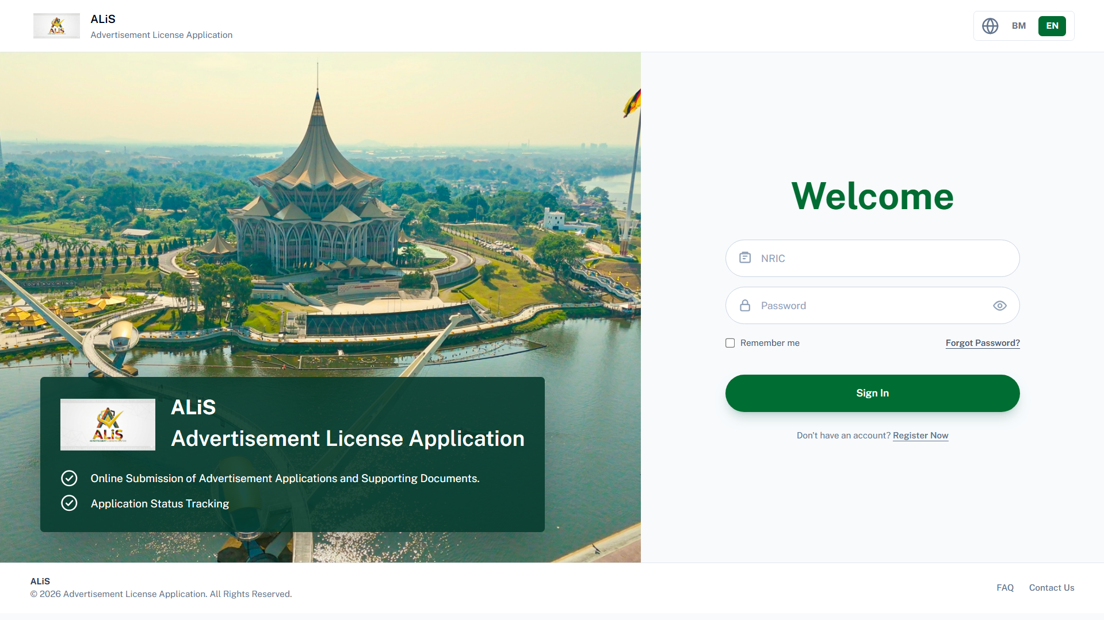

Slide 9
Frequently Asked Questions
(FAQ)

Slide 10
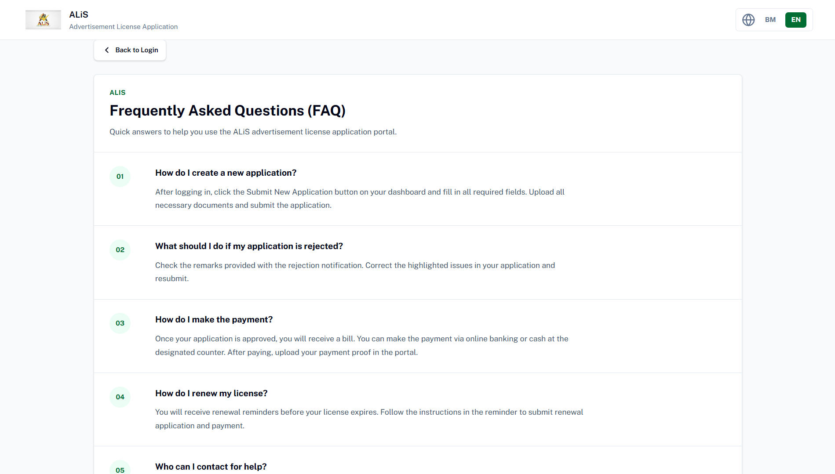

Slide 11
Account Registration
(Applicant)

Slide 12
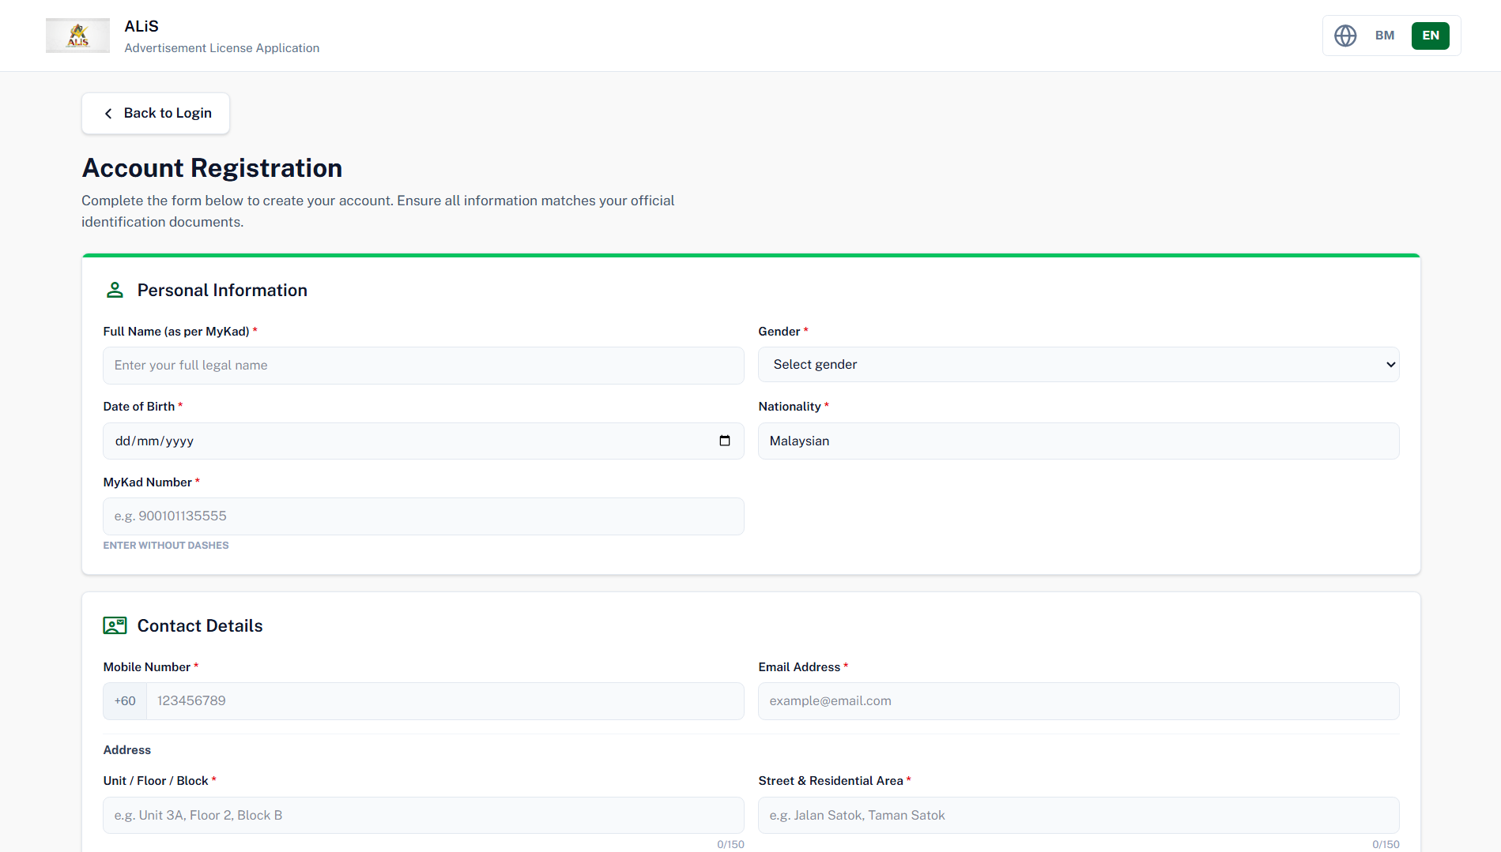

Slide 13
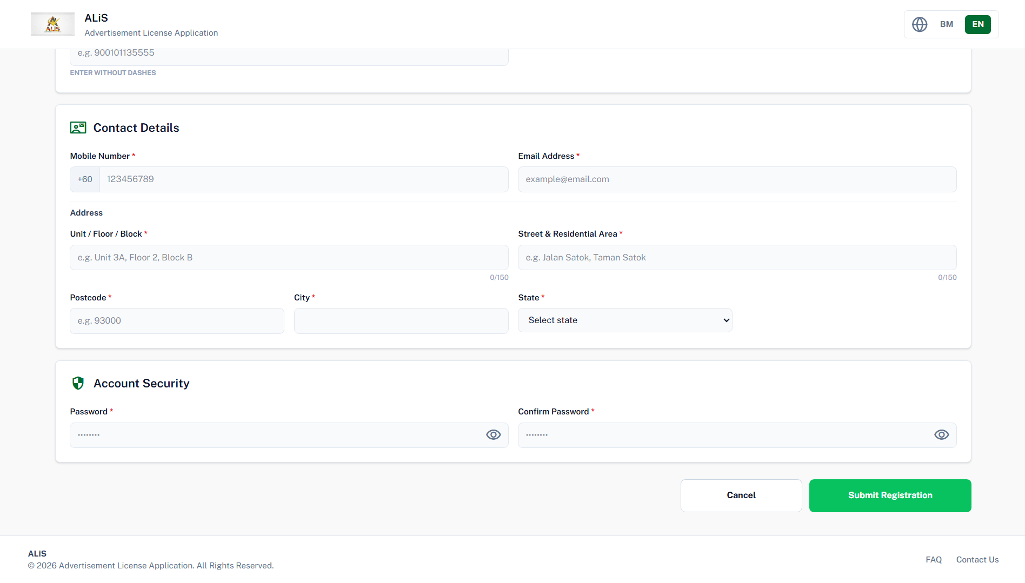

Slide 14
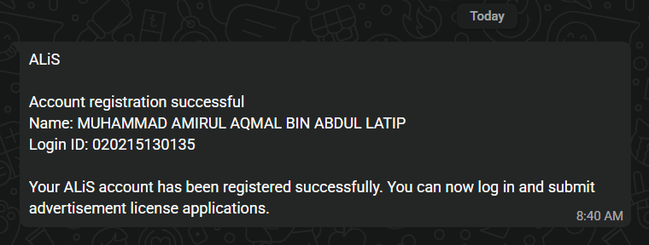

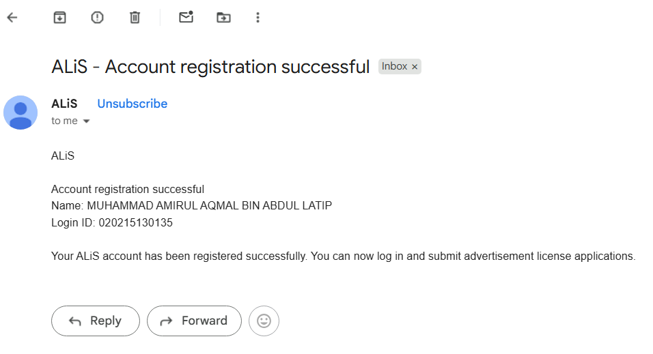

Notification

Slide 15
Account Recovery

Slide 16
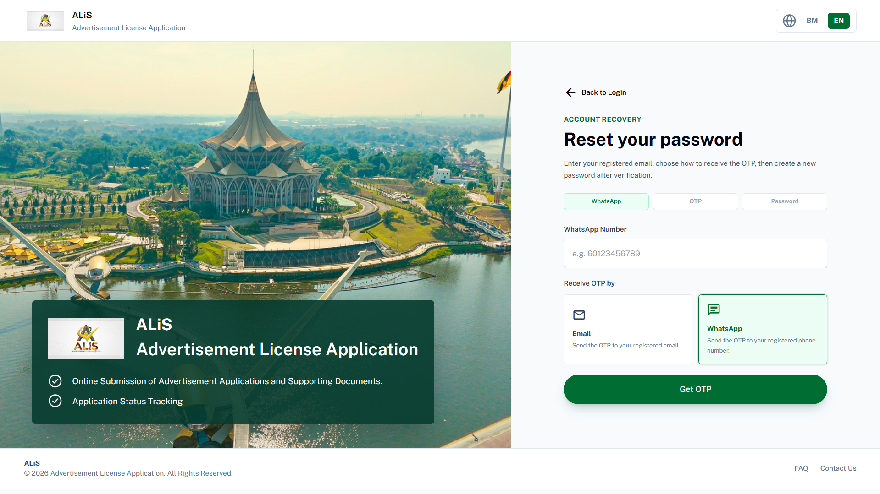

Slide 17
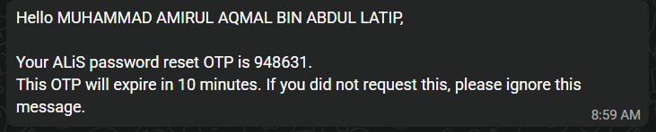
One-Time Password (OTP)
via WhatsApp/Email

Slide 18
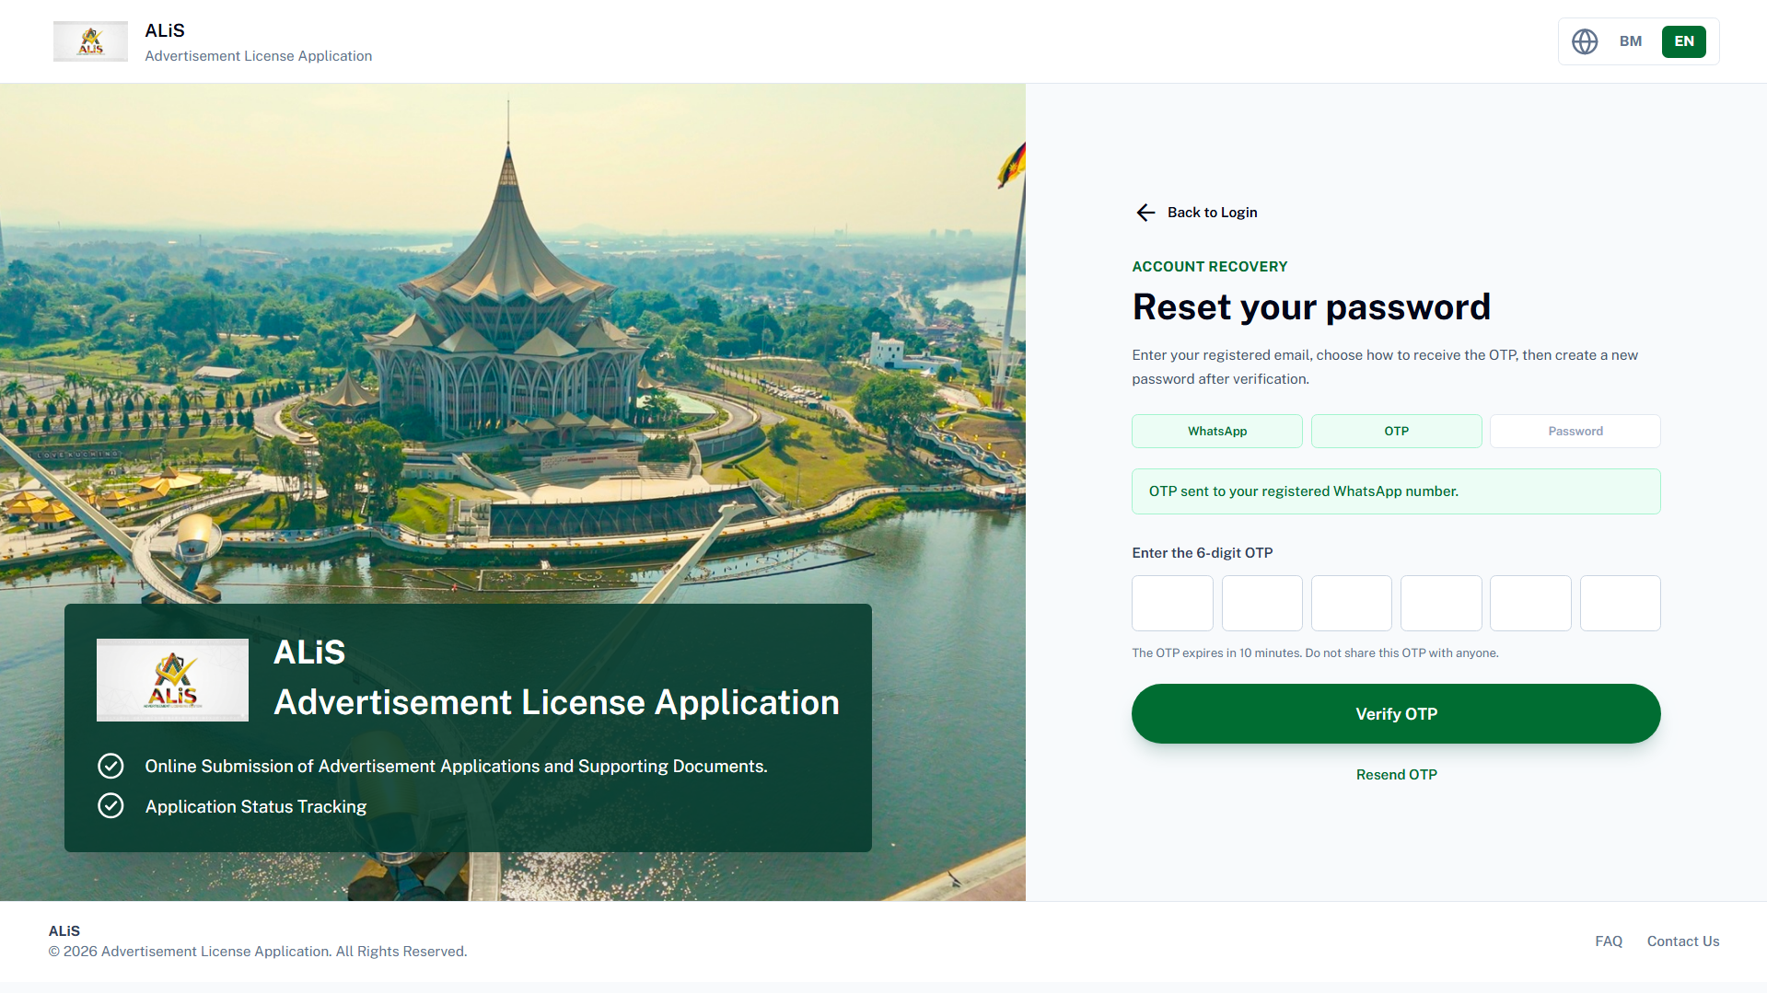

Slide 19
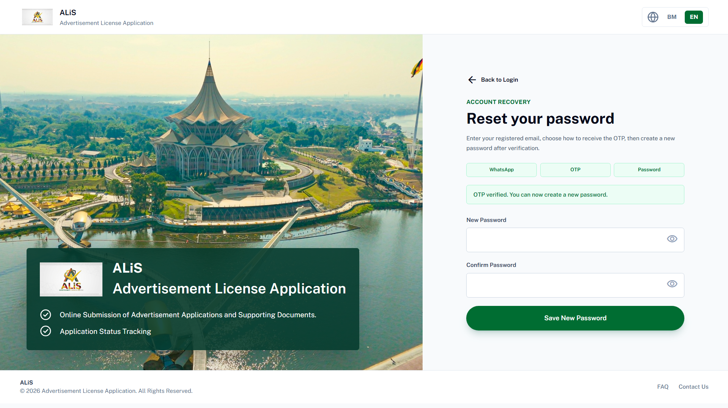

Slide 20
Super Admin
(Manage All Account)

Slide 21
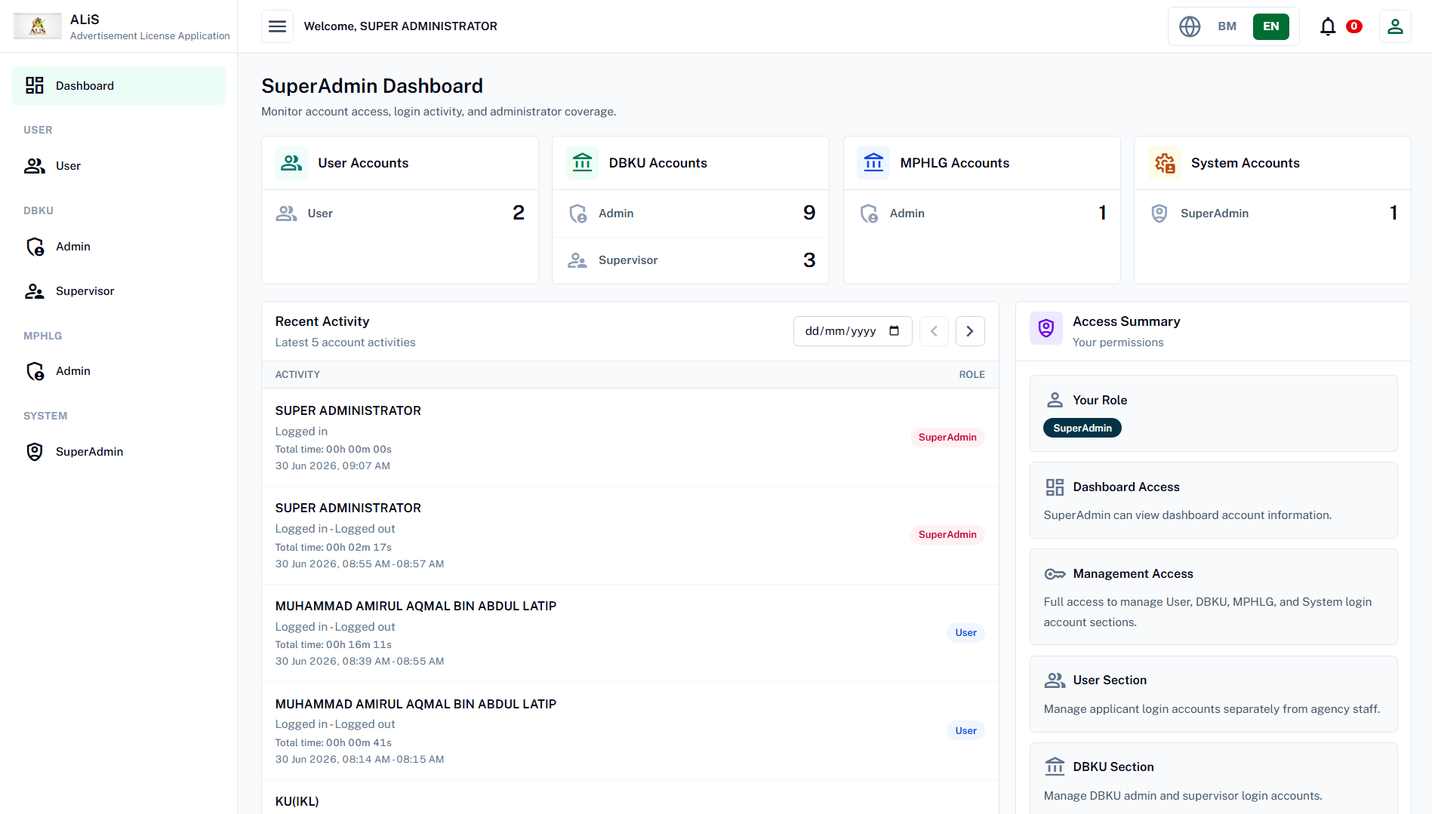

Slide 22
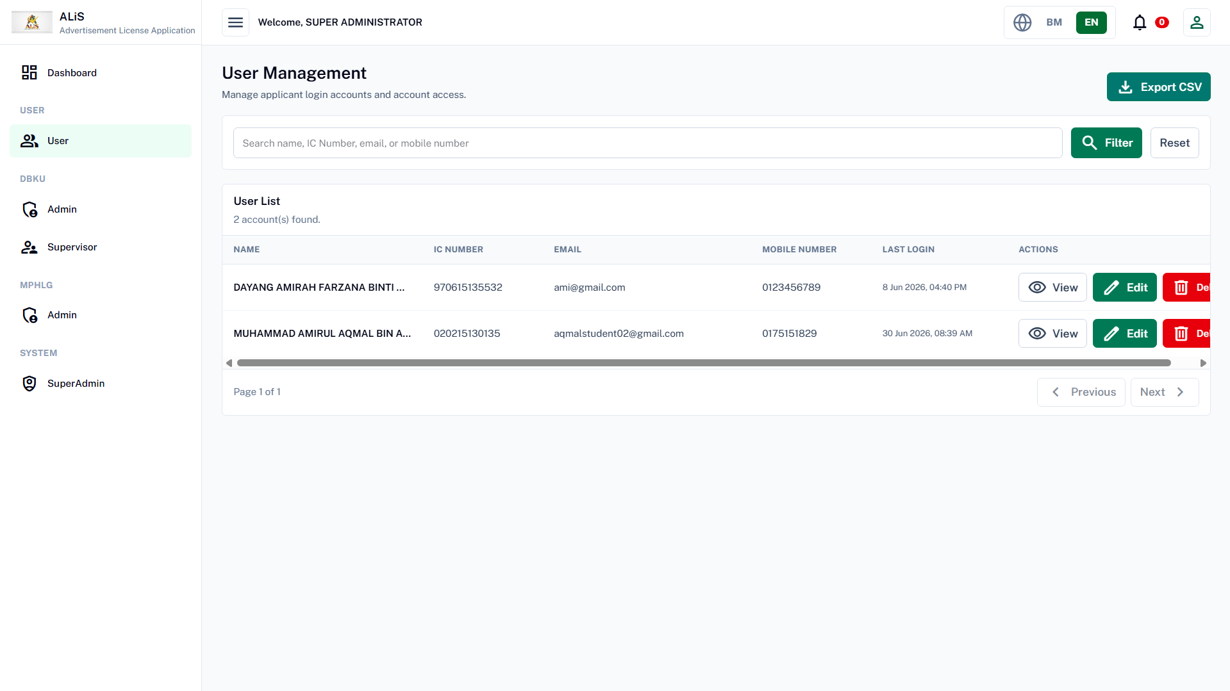

Slide 23
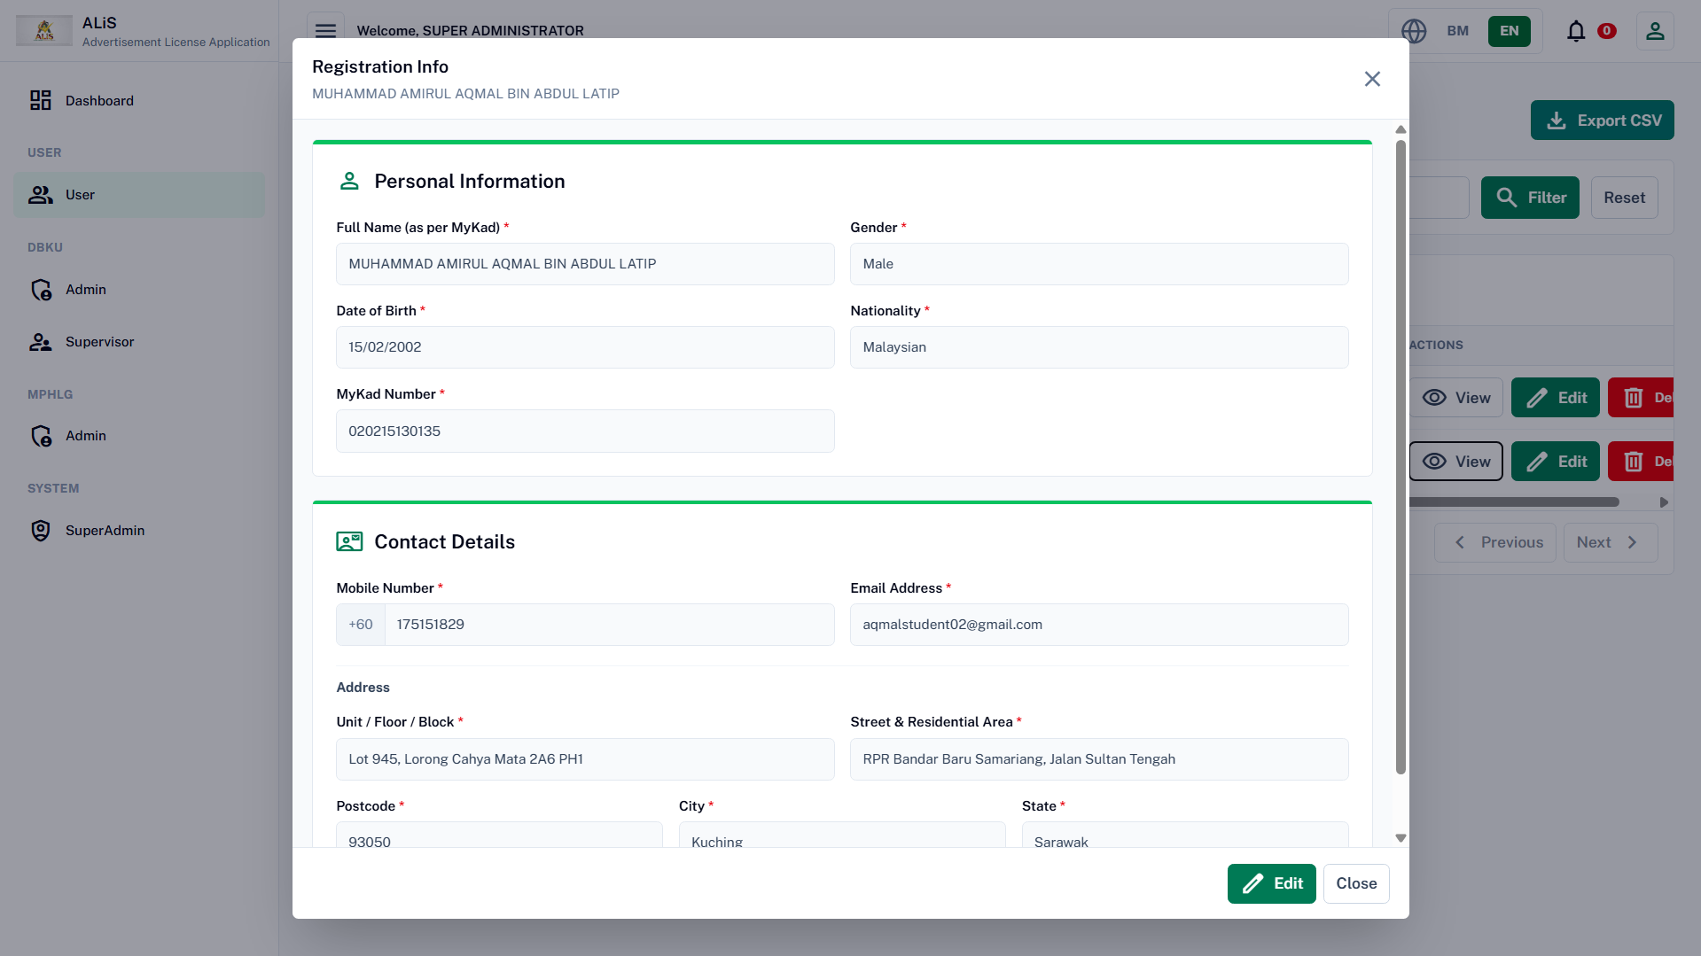

Slide 24
Account Registration
(Internal DBKU/MPHLG)

Slide 25
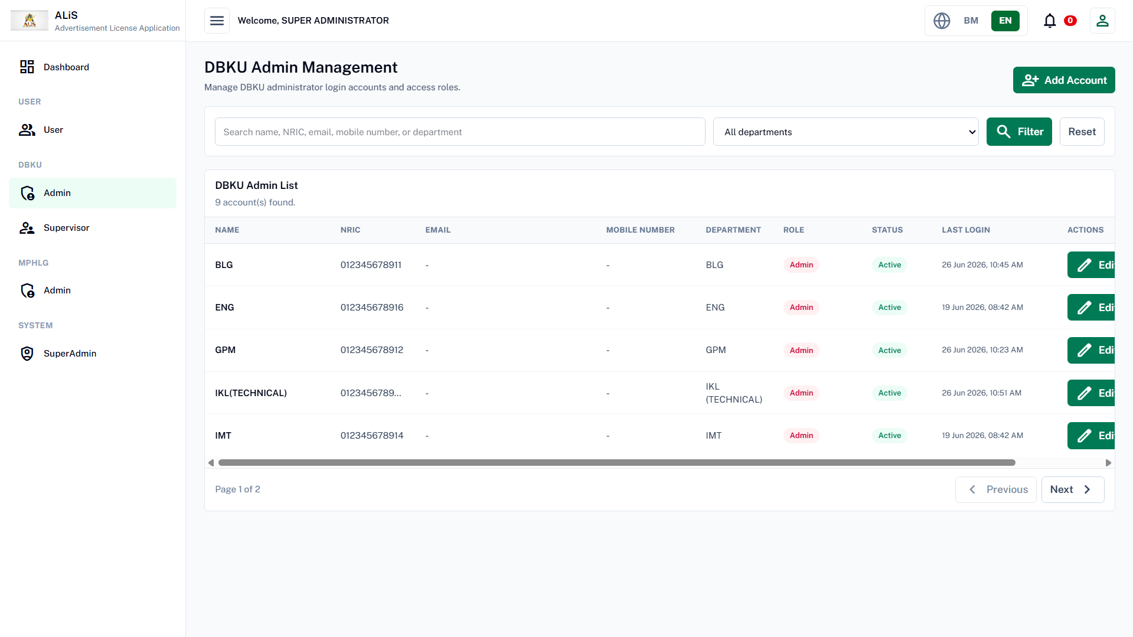

Slide 26
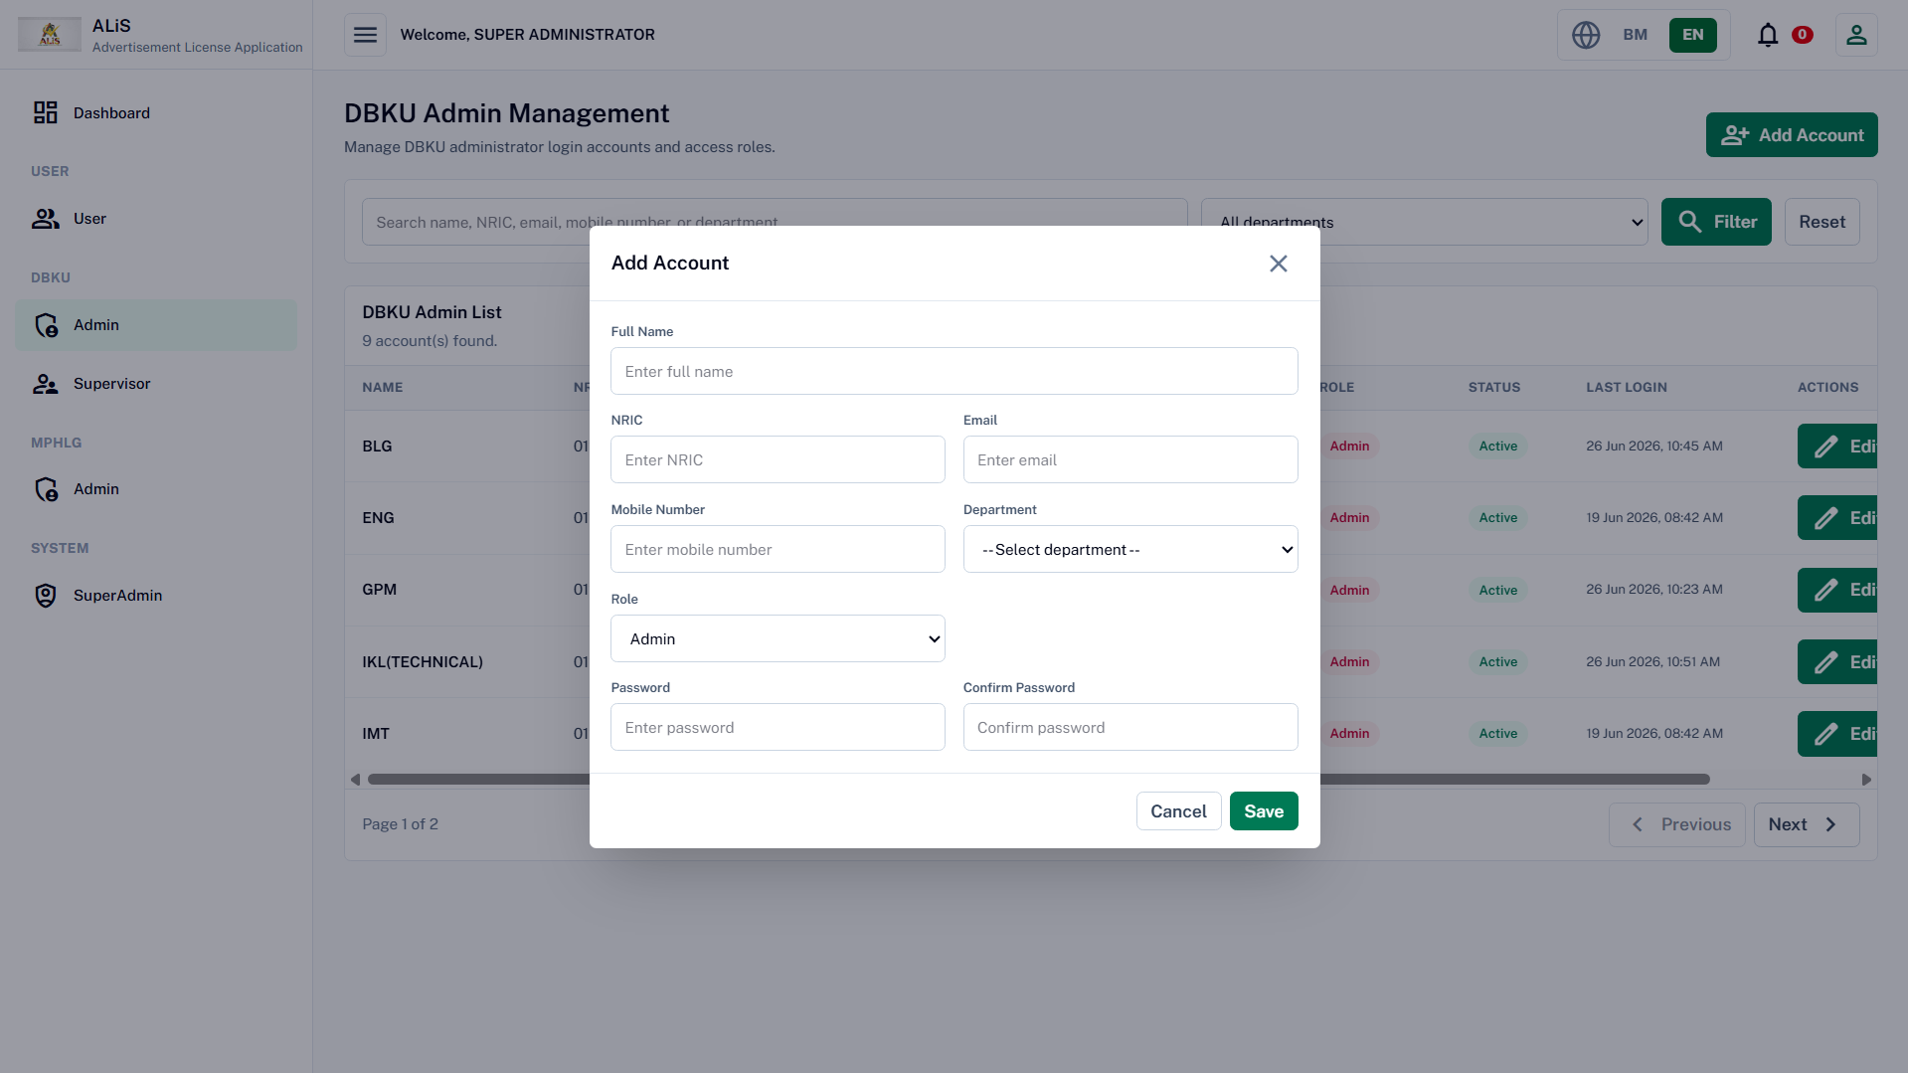

Slide 27
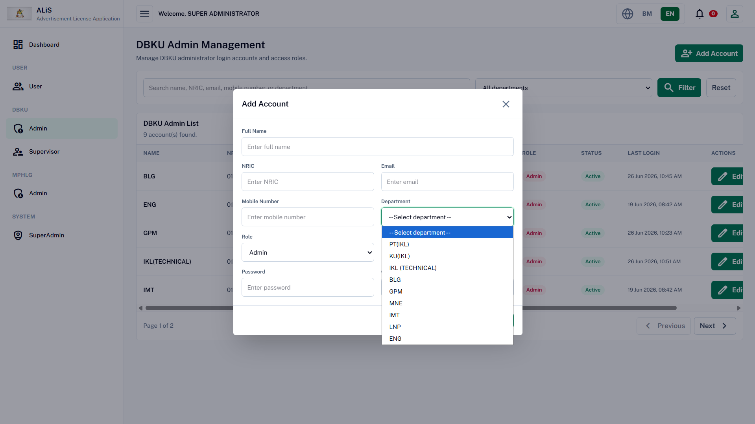

Slide 28
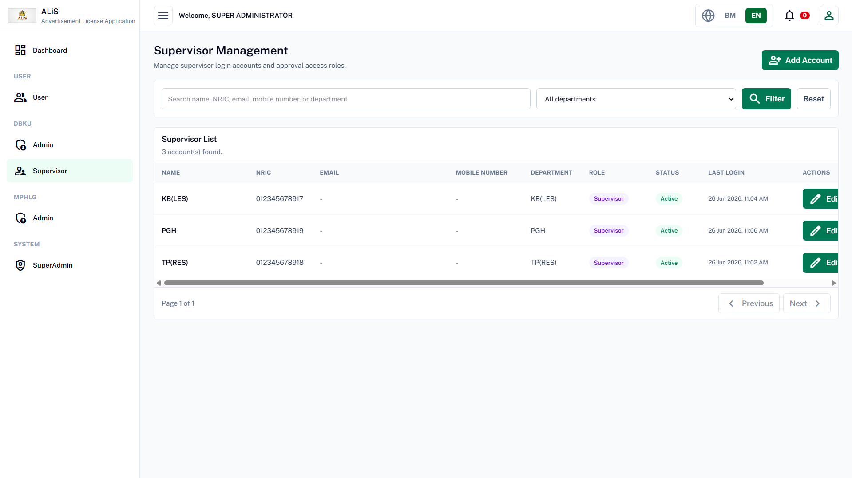

Slide 29
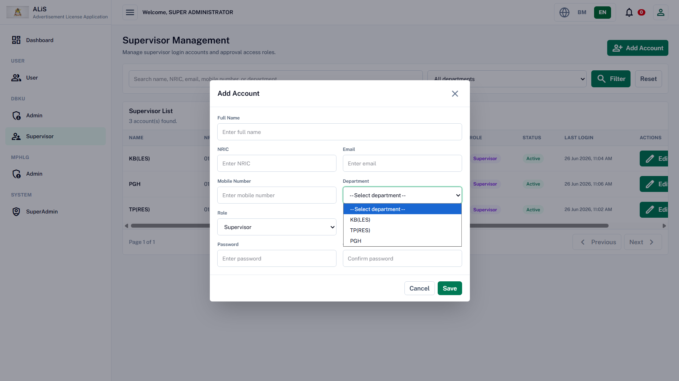

Slide 30
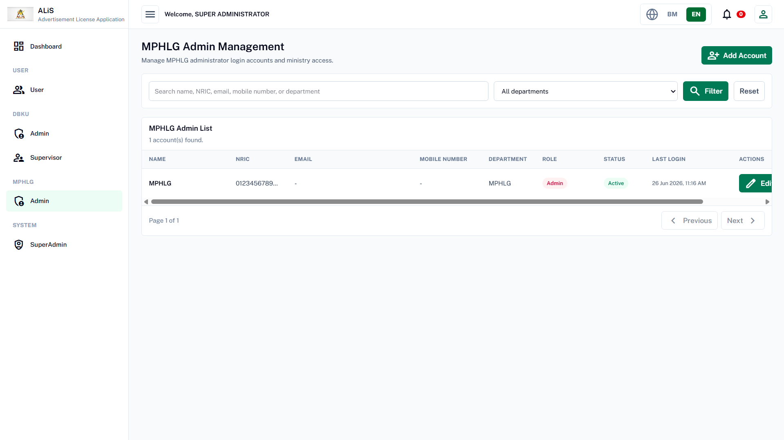

Slide 31
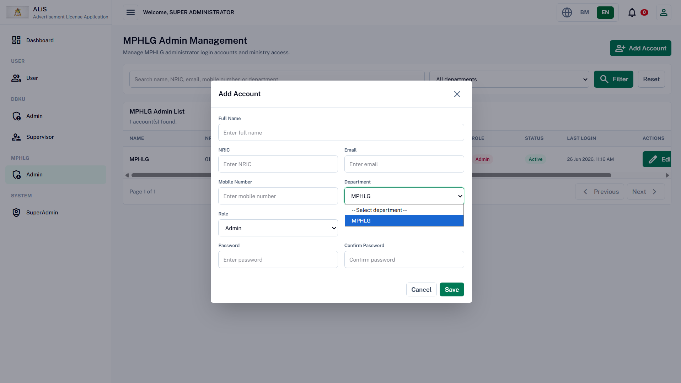

Slide 32
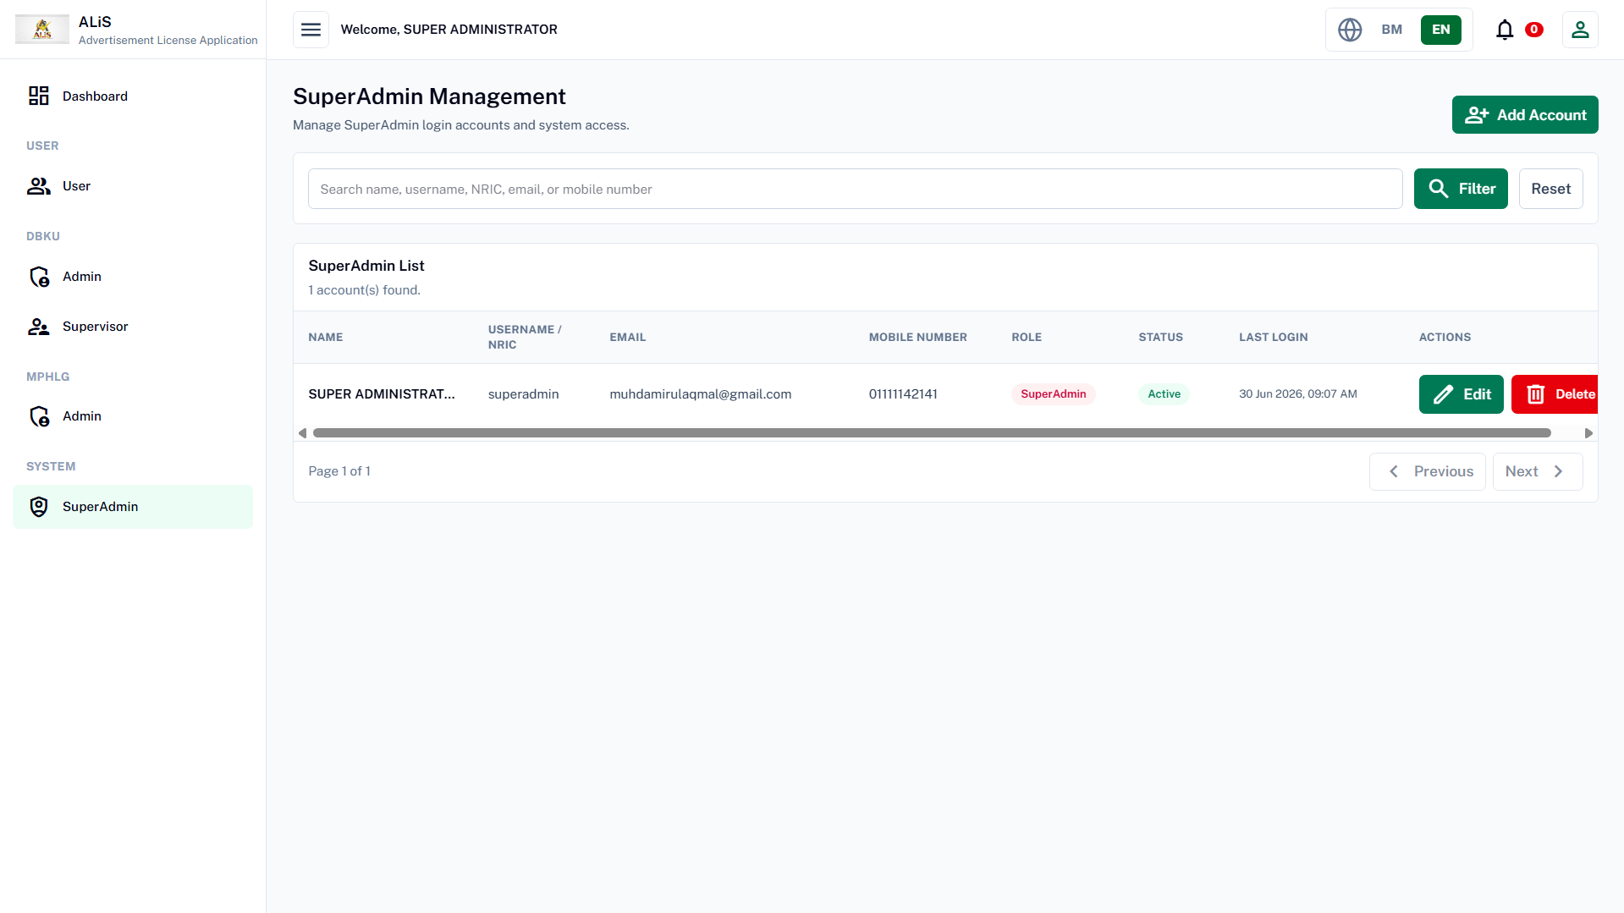

Slide 33
Applicant (user)
View

Slide 34
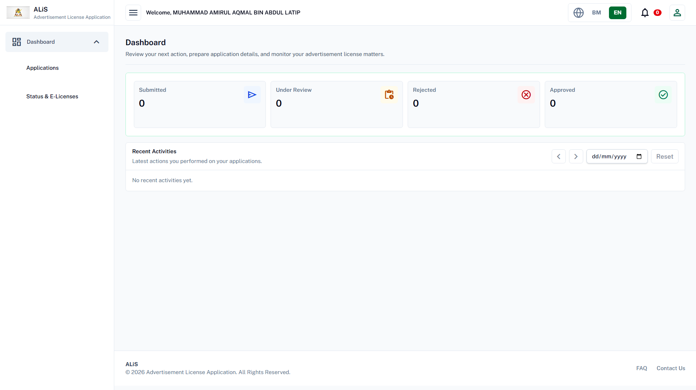

Slide 35
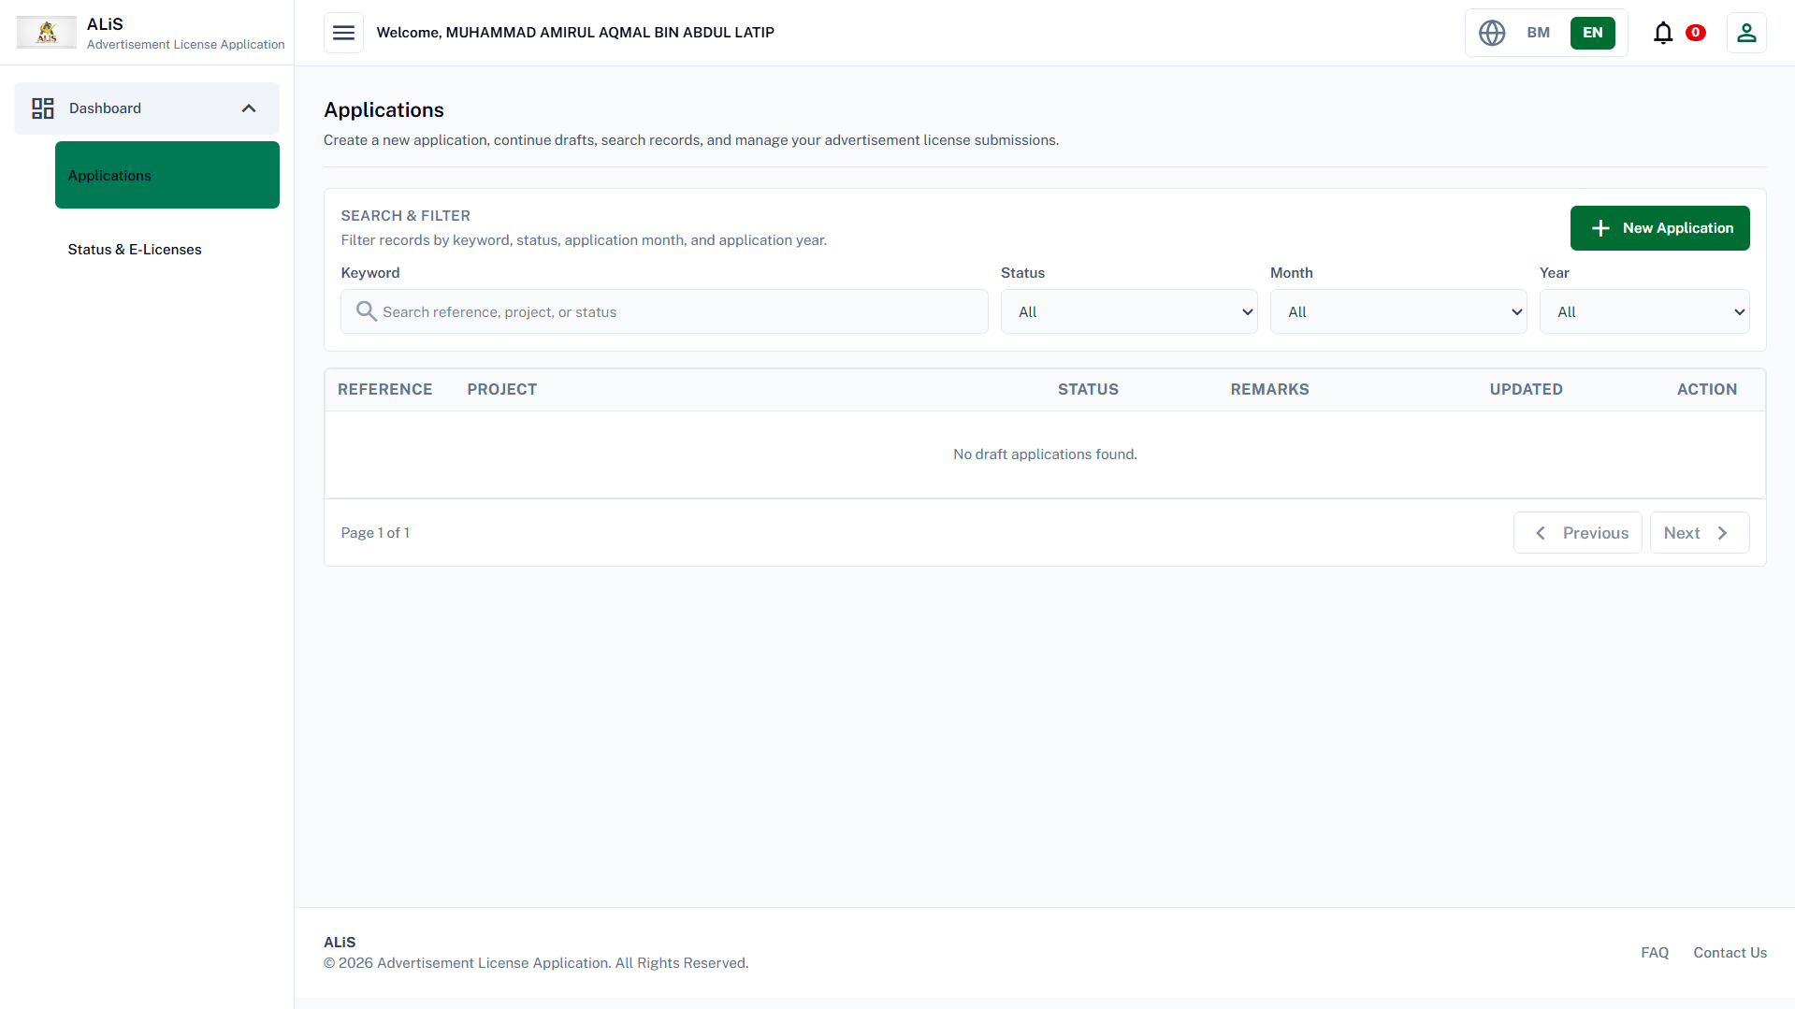

Slide 36
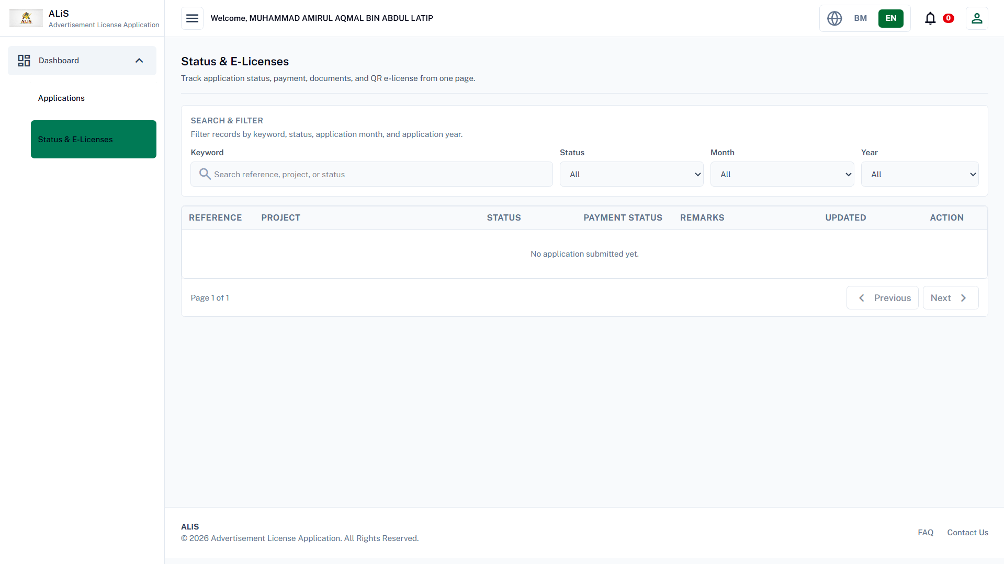

Slide 37
Create New
Application

Slide 38
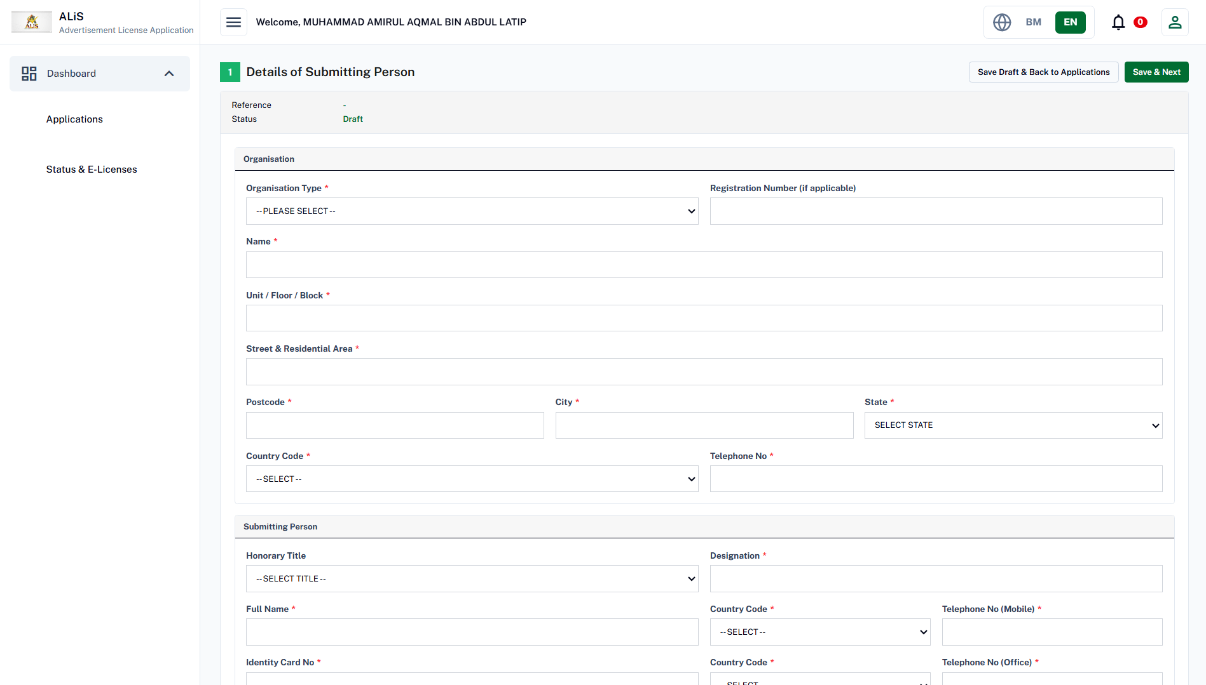

Slide 39
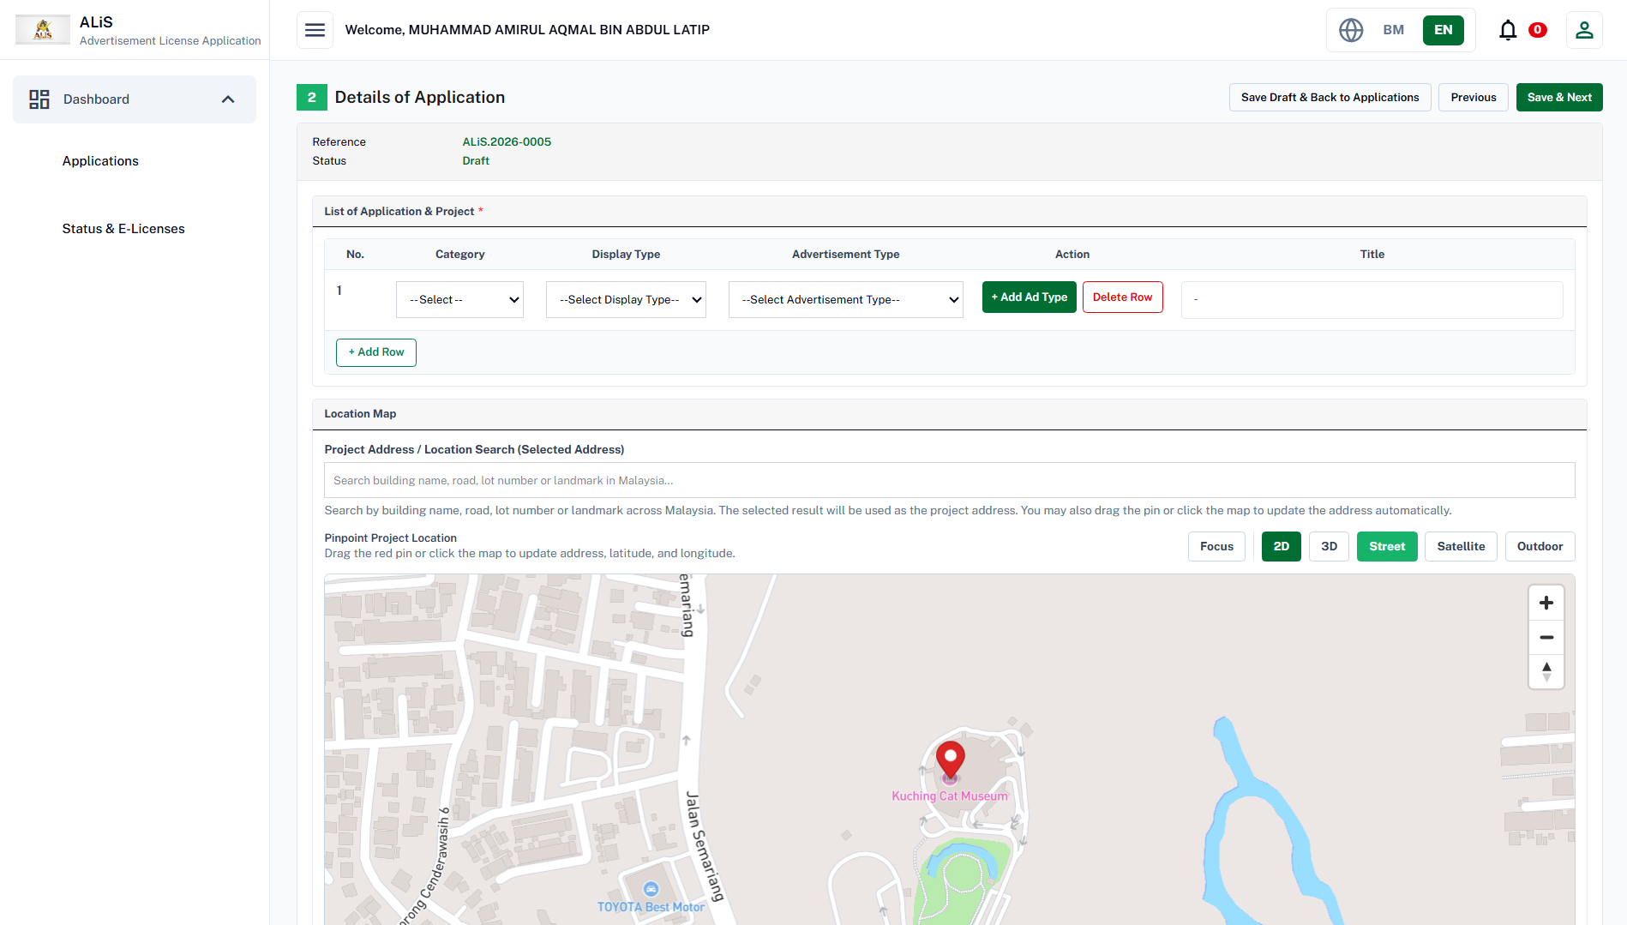

Slide 40
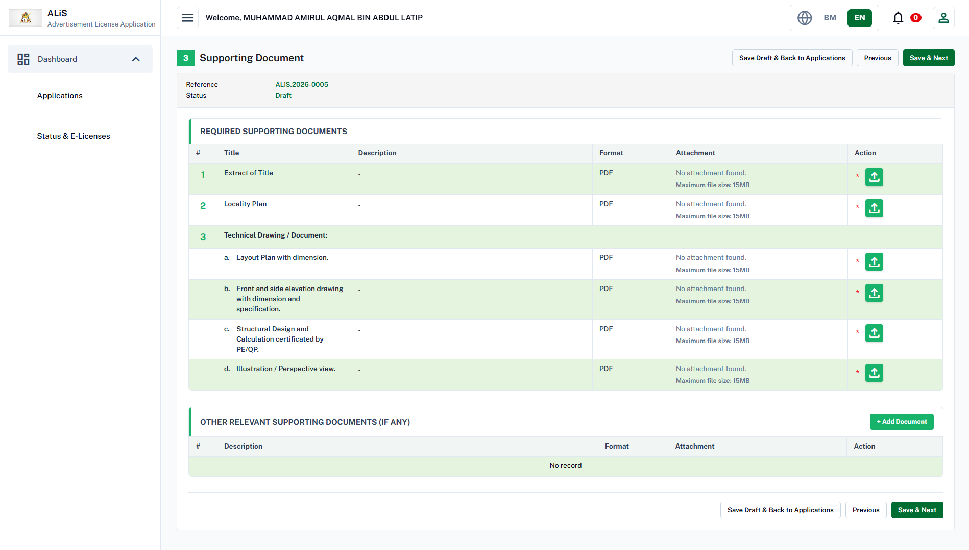

Slide 41
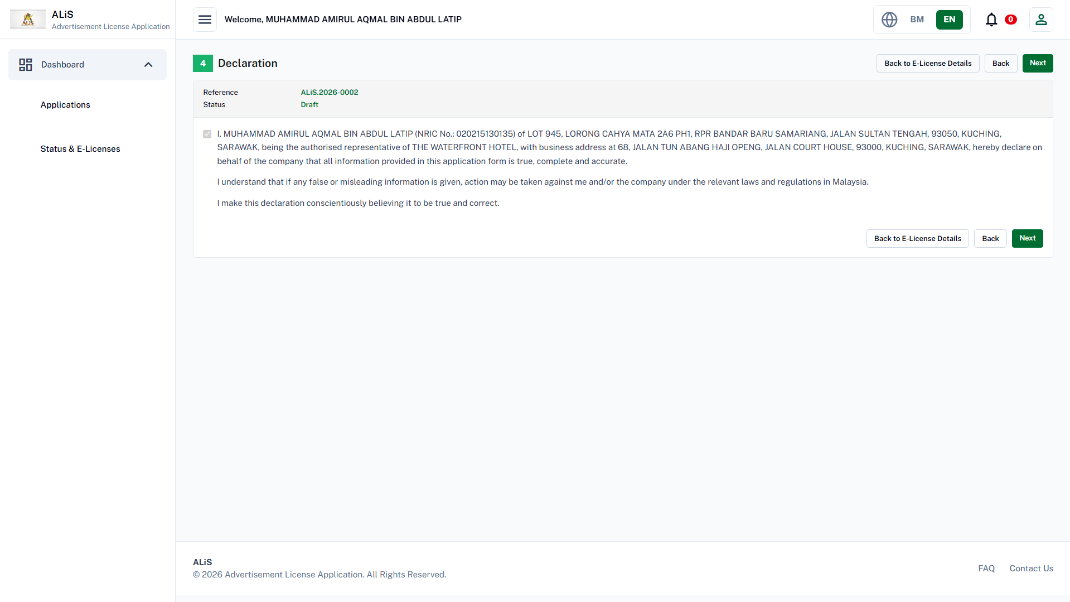
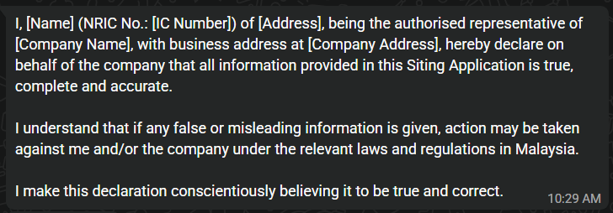
TEMPLATE

Slide 42
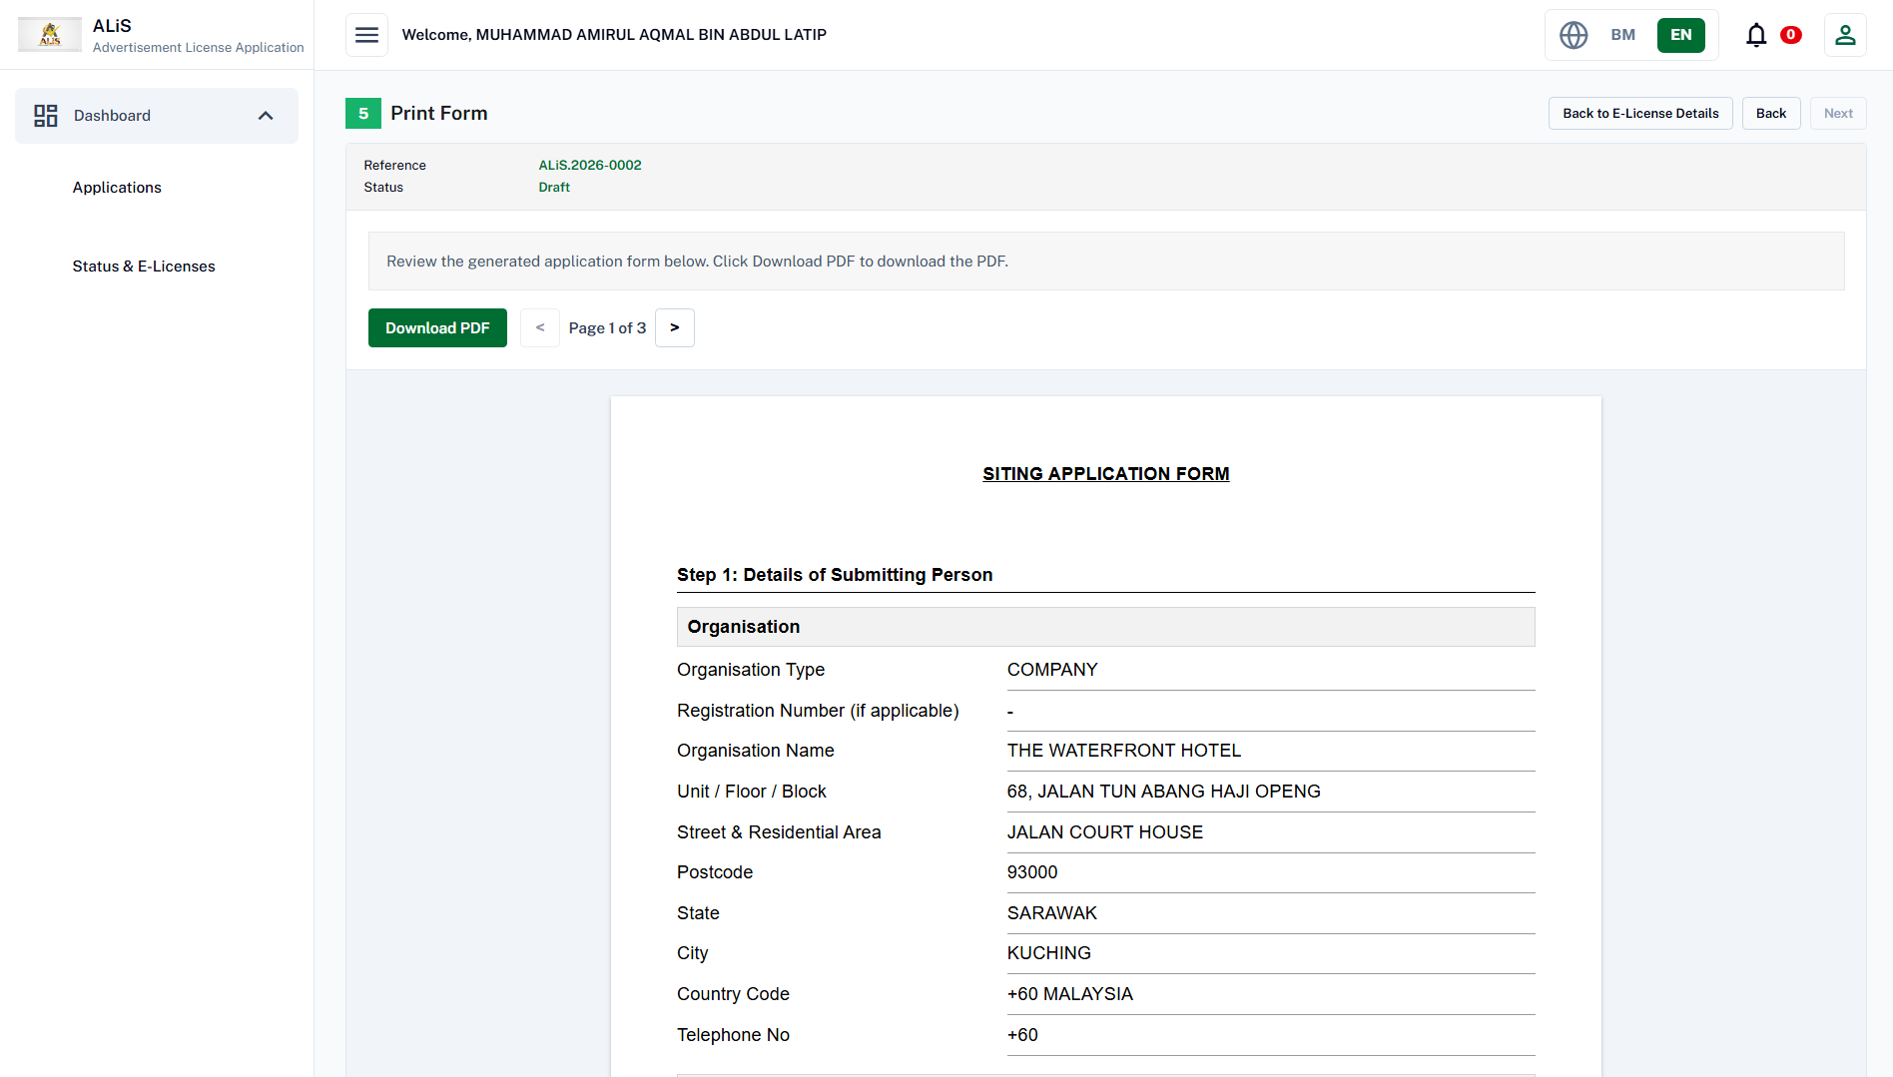

Slide 43
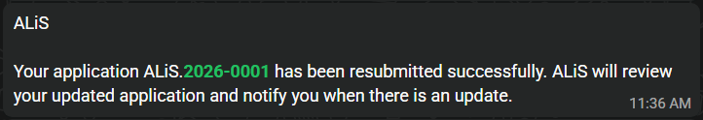
Notification Success

Slide 44

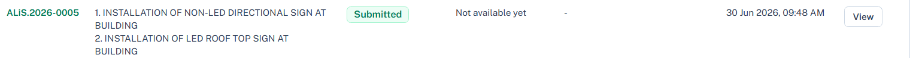

Slide 45
PERSONAL TASK

Slide 46
KU(IKL) Review

Slide 47
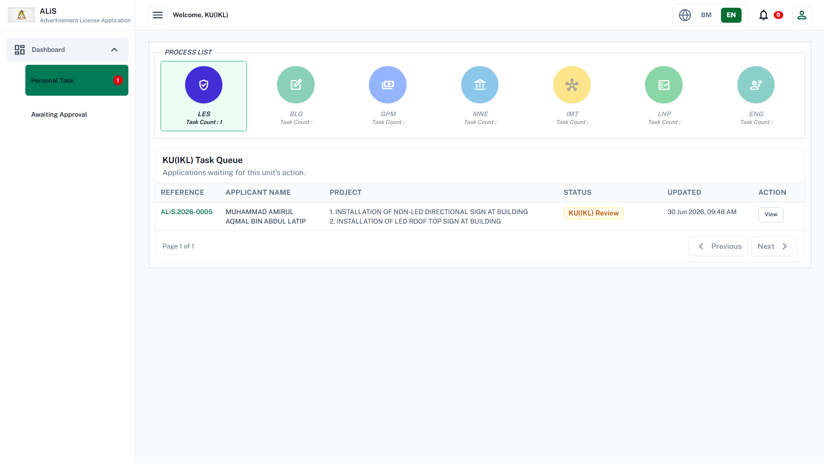

Slide 48
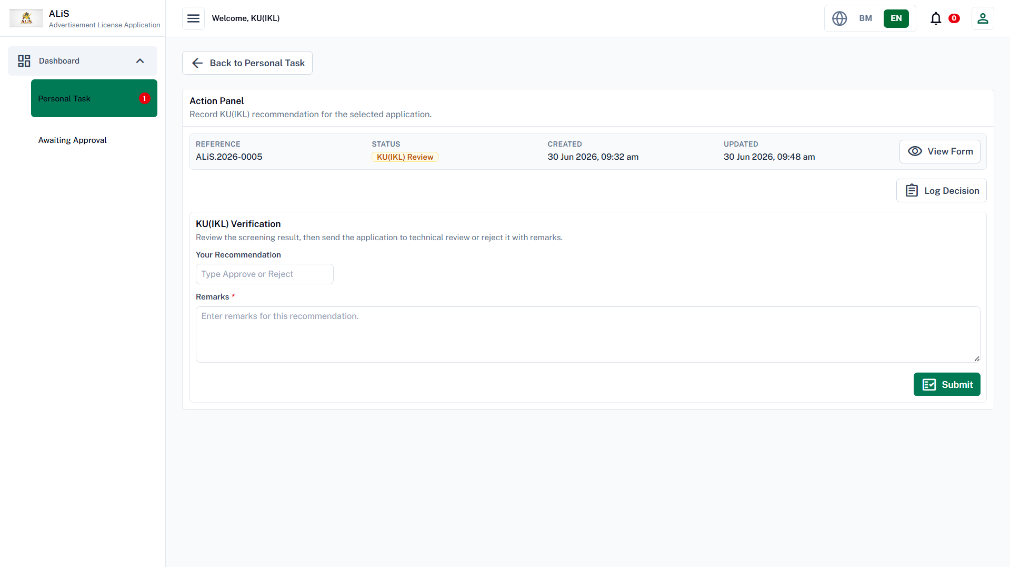

Slide 49
BLG Review

Slide 50
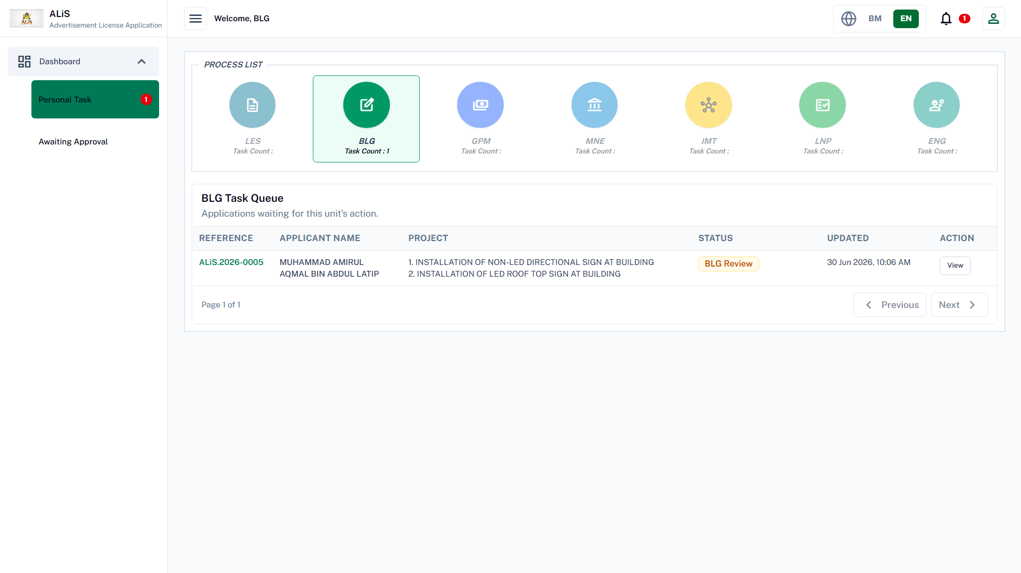

Slide 51
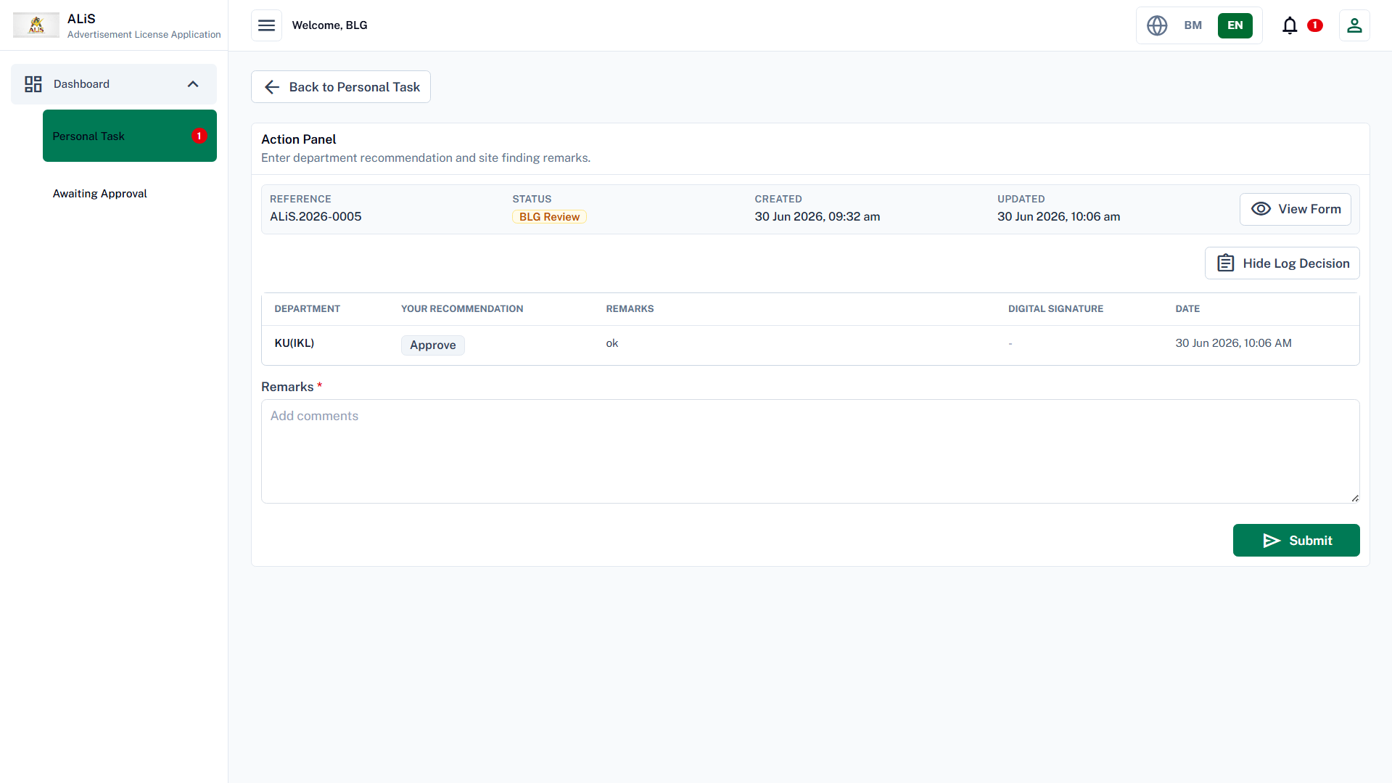

Slide 52
IKL(TECHNICAL) Review

Slide 53
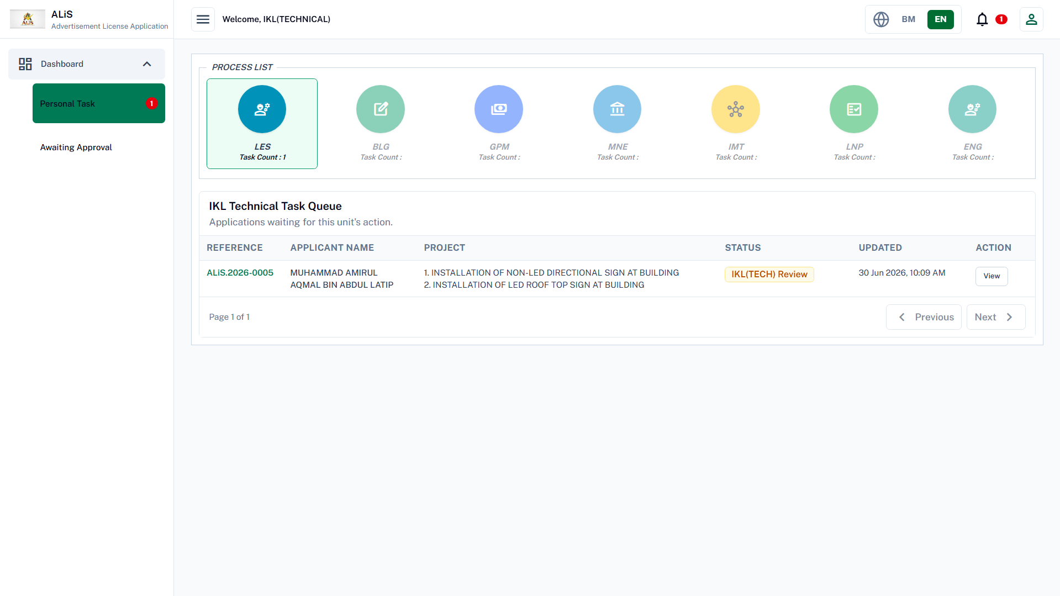

Slide 54
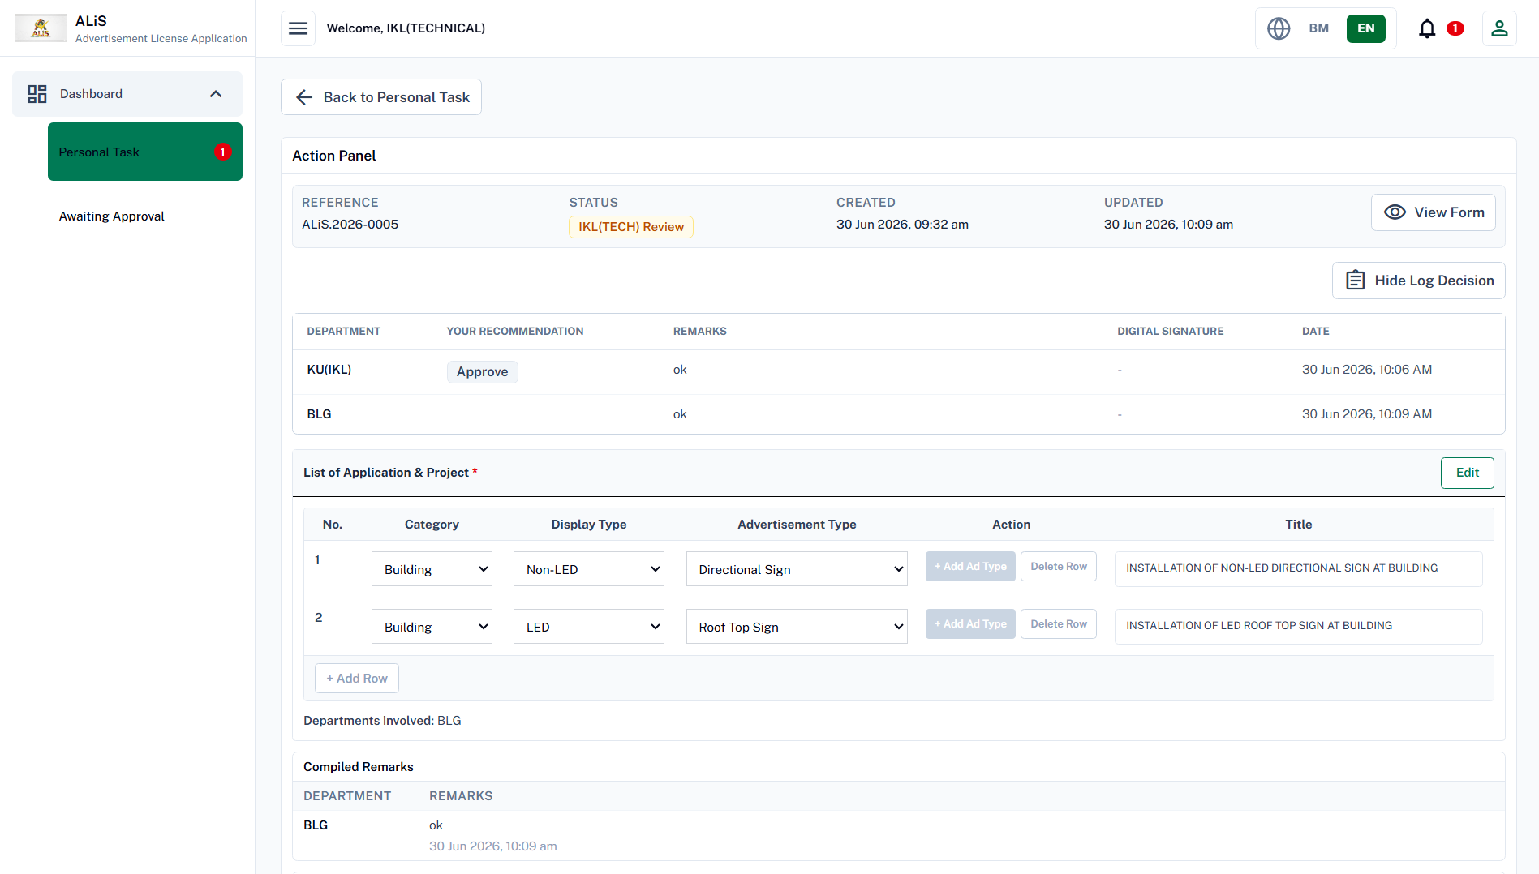

Slide 55
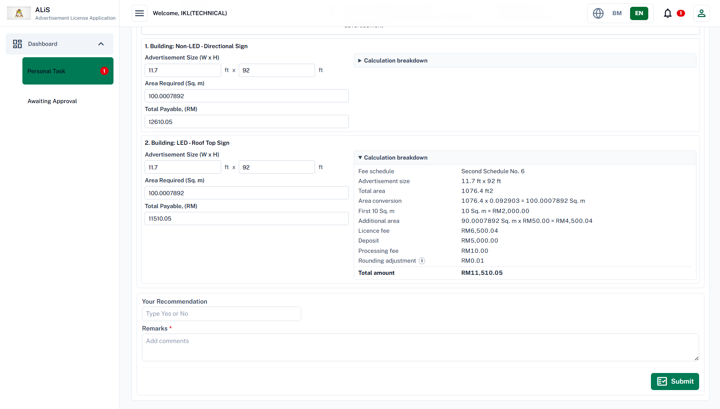

Slide 56
KU(IKL) Final Check

Slide 57
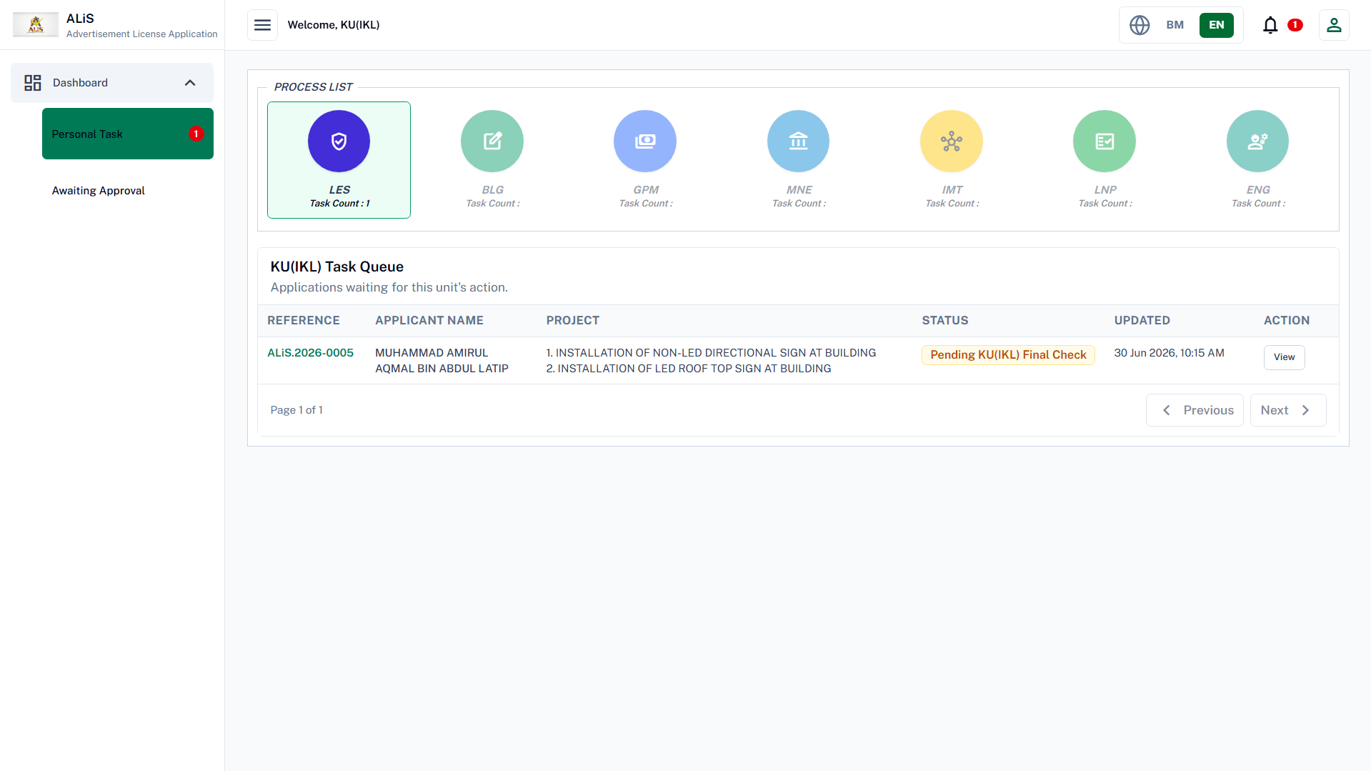

Slide 58
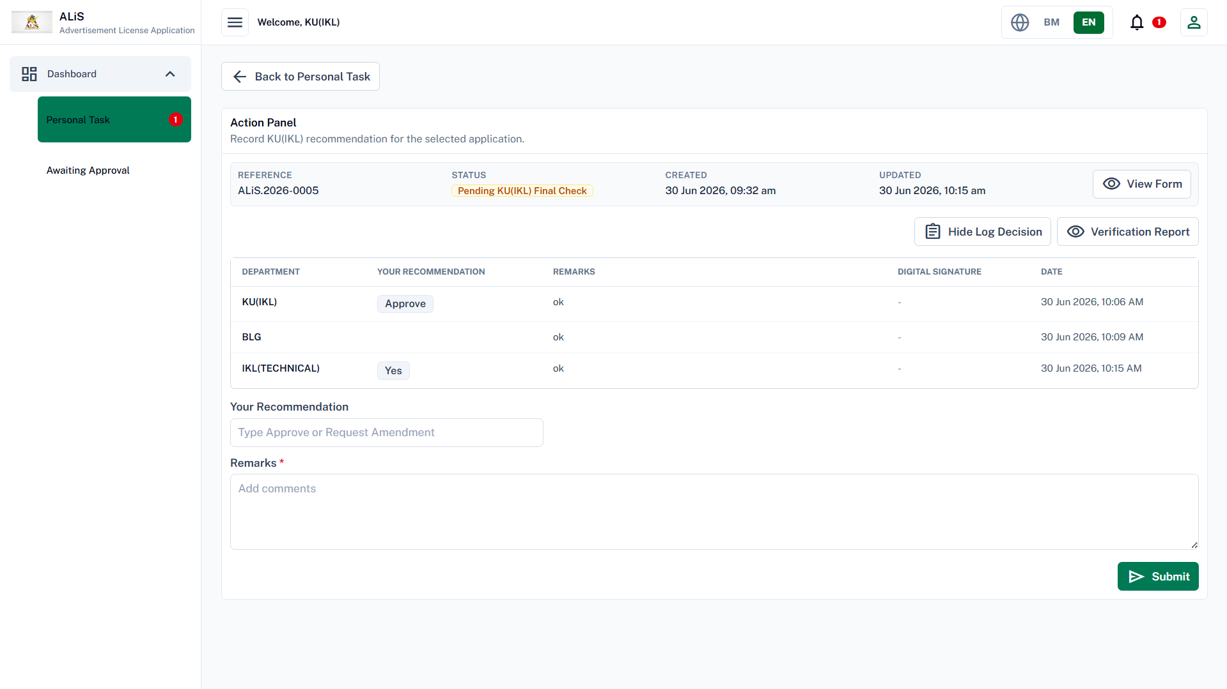

Slide 59
KB(LES) Verification

Slide 60
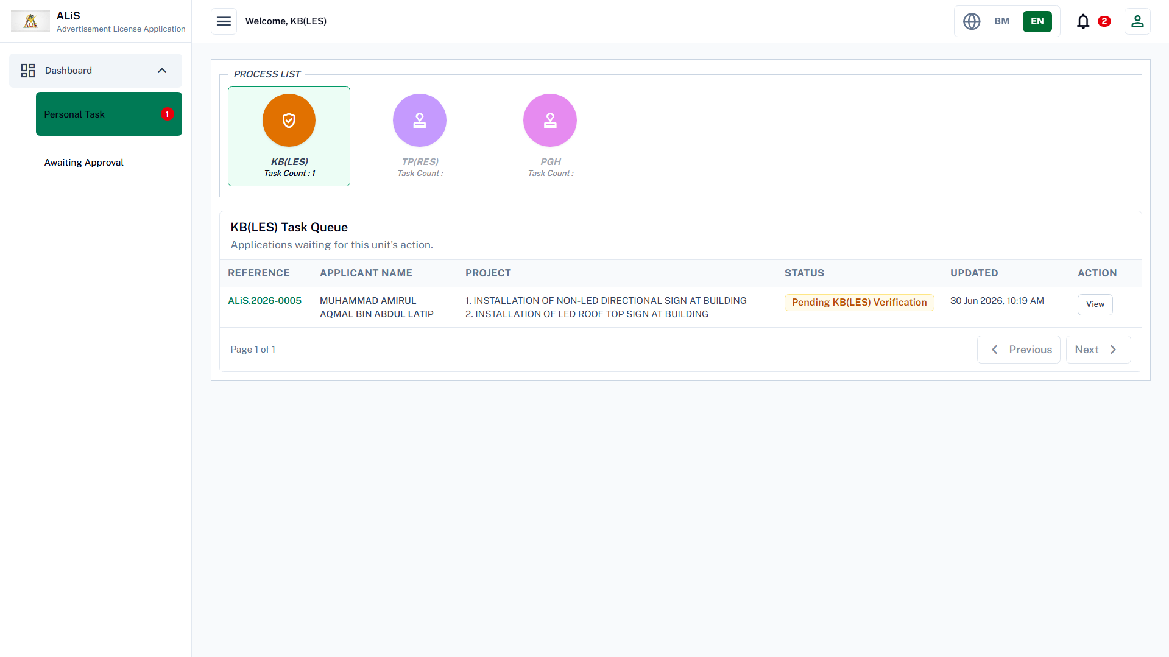

Slide 61
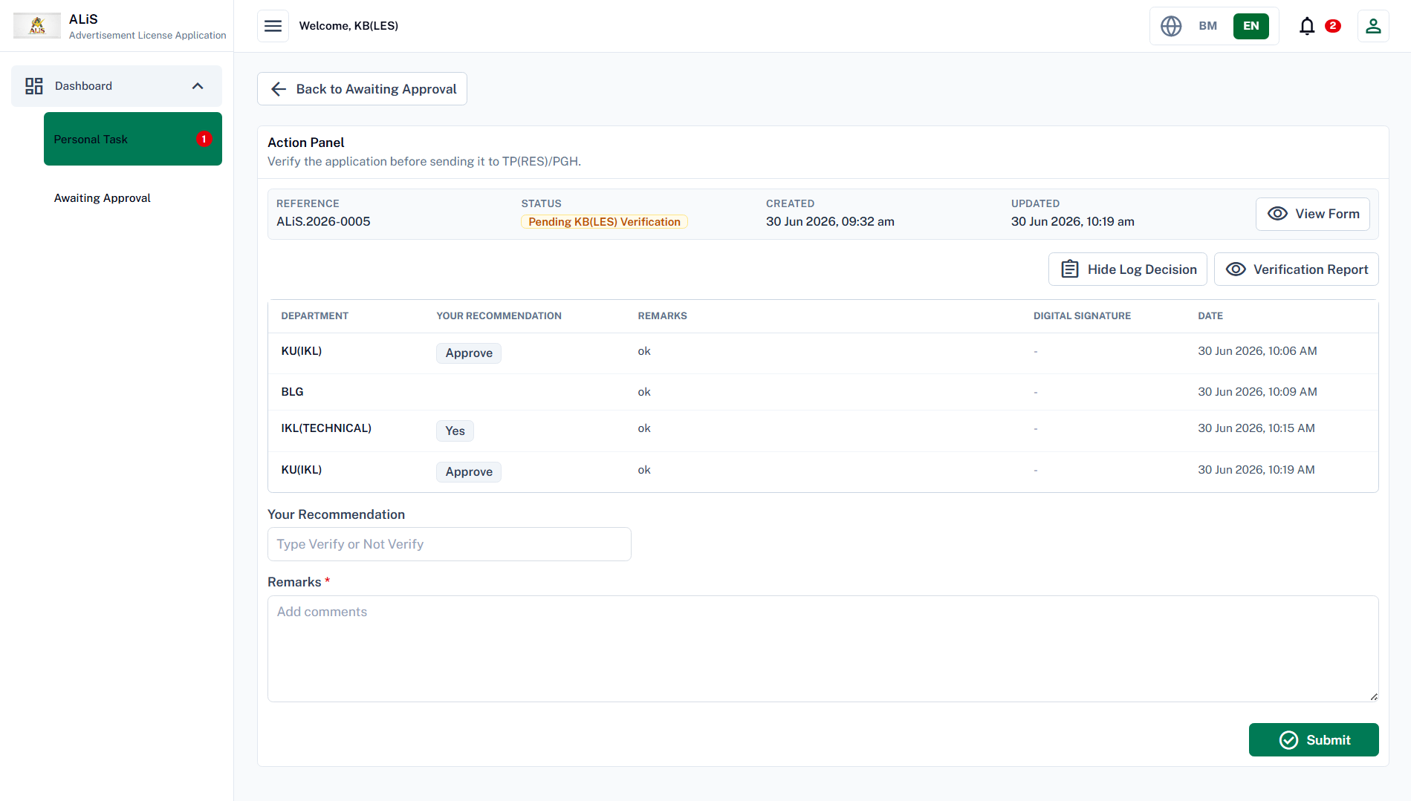

Slide 62
TP(RES)/PGH
Final Approval

Slide 63
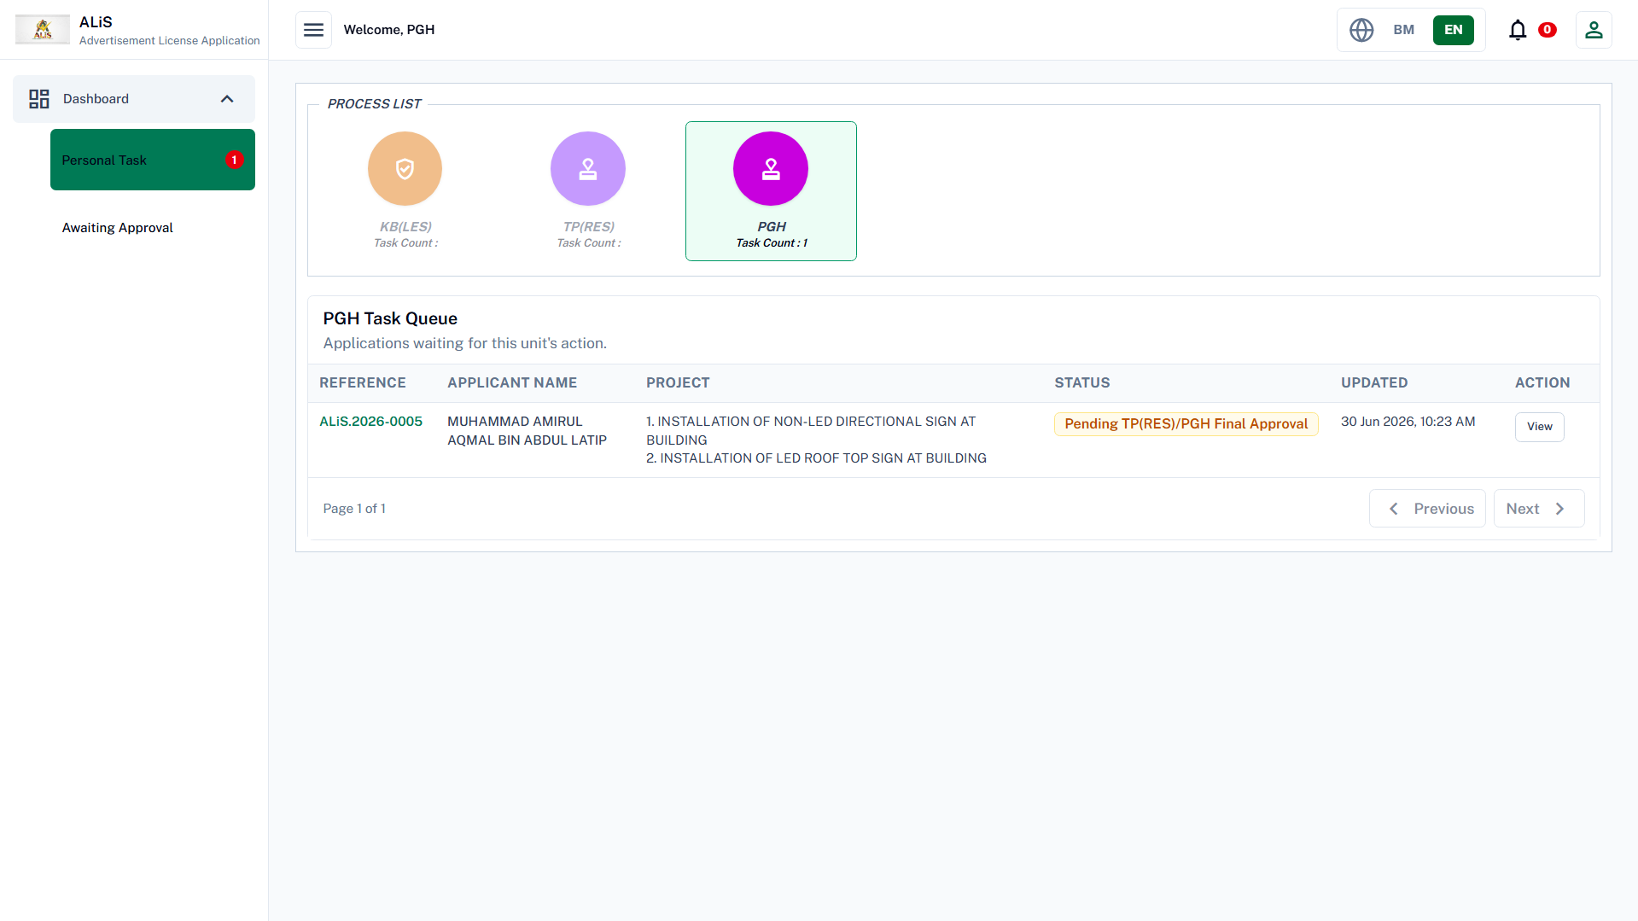

Slide 64
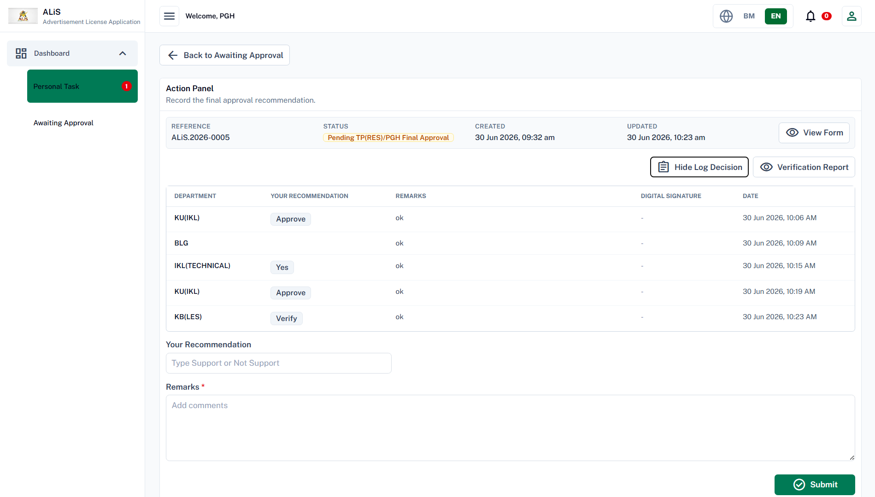

Slide 65
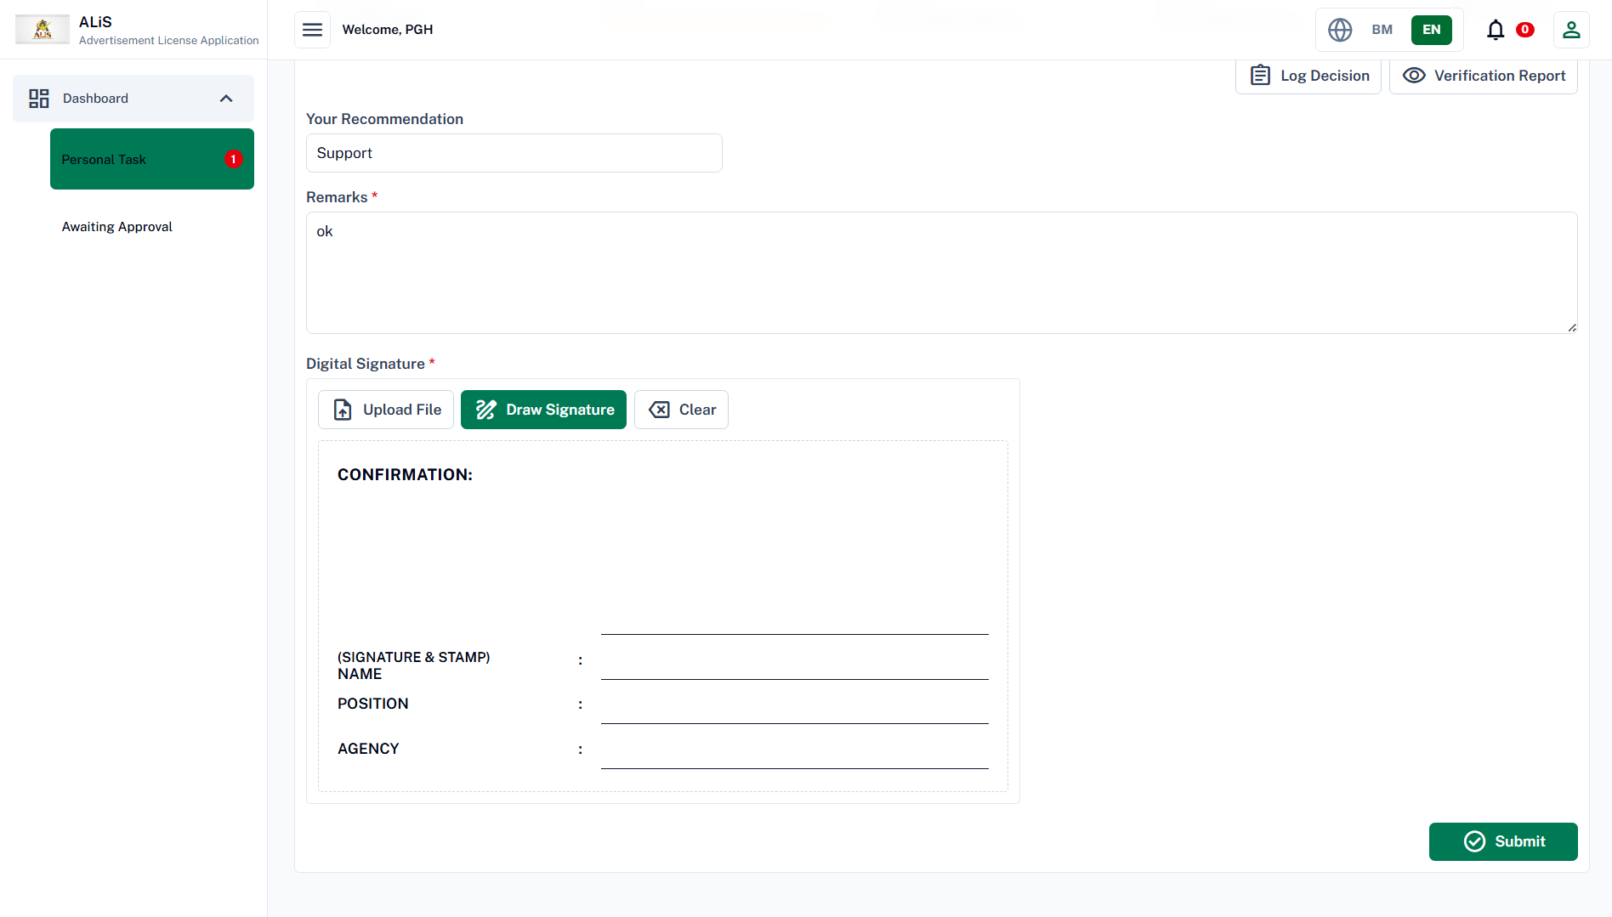

Slide 66
MPHLG

Slide 67
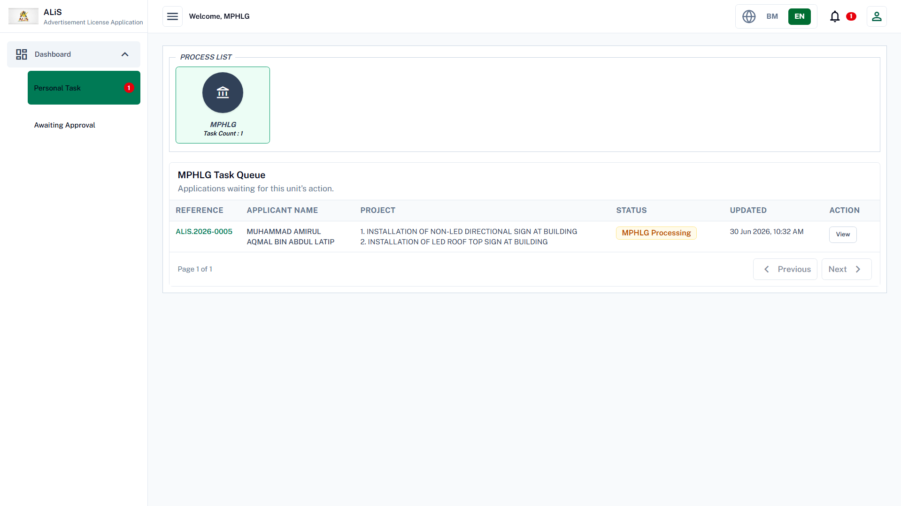

Slide 68
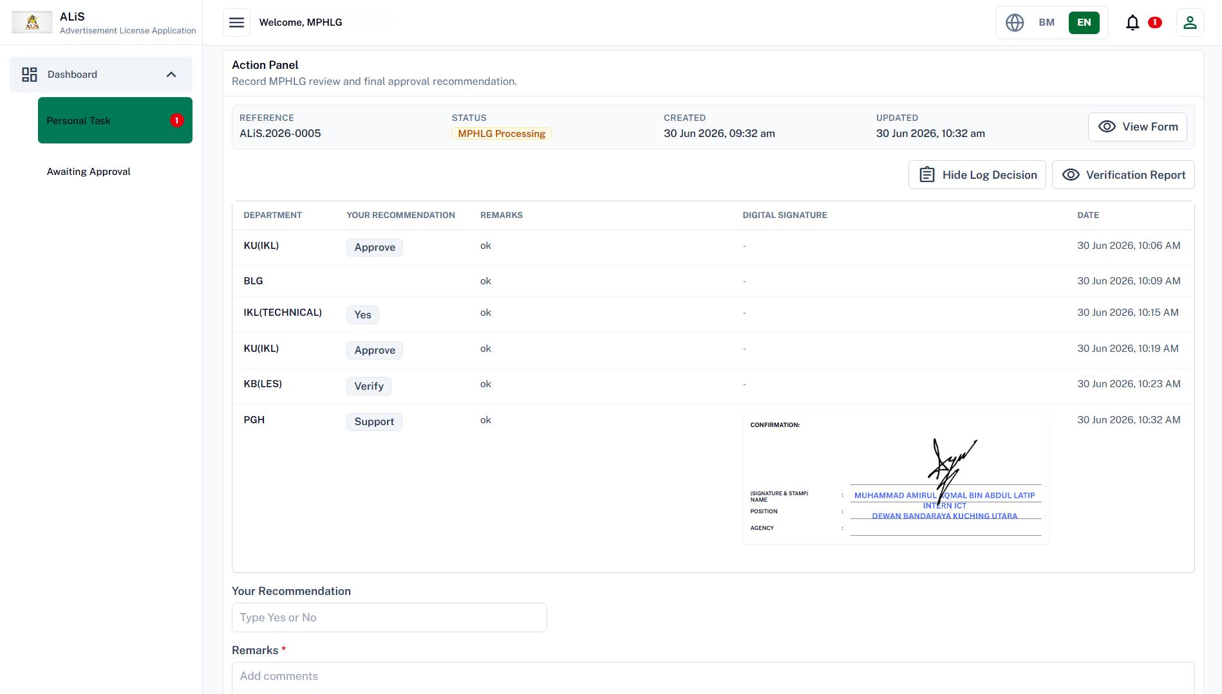

Slide 69
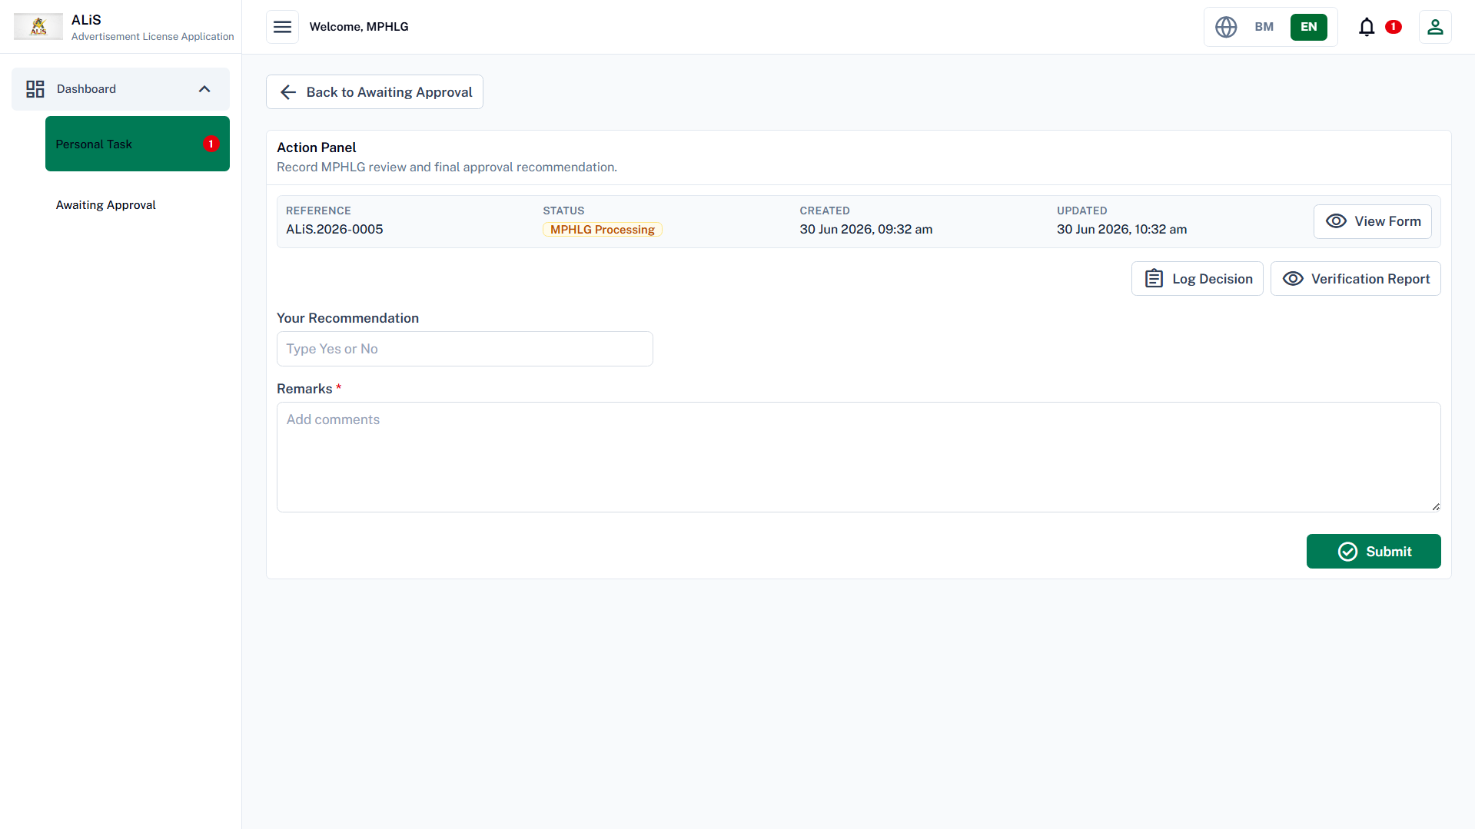

Slide 70
PT(IKL)
Generate Approval Letter & Bill

Slide 71


Slide 72
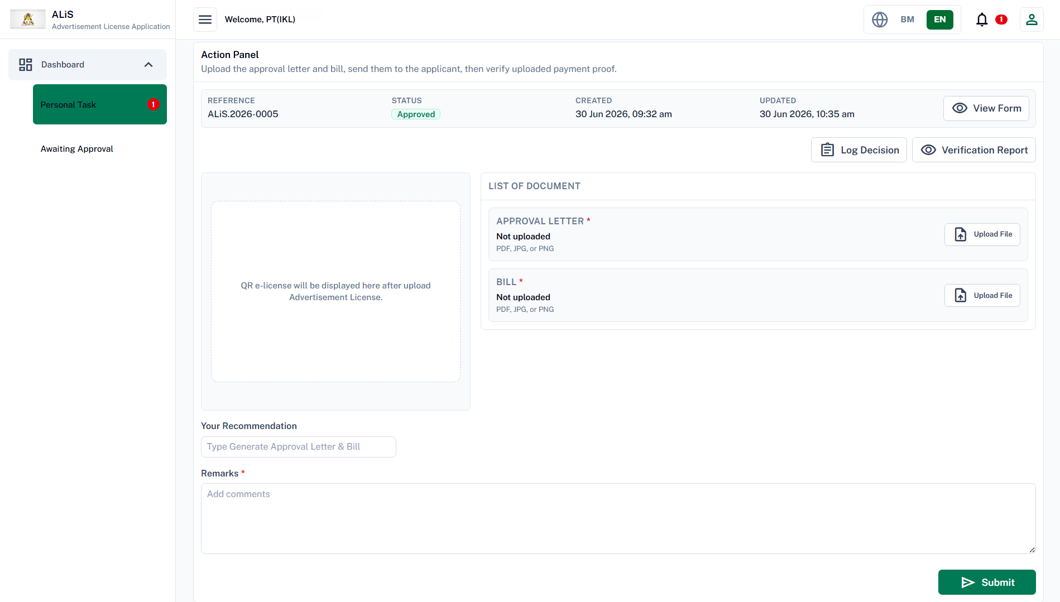

Slide 73
Applicant (user)
Upload Receipt

Slide 74



Slide 75


Slide 76


Slide 77
PT(IKL)
Review Receipt, Generate OR
& Advertisement License

Slide 78


Slide 79


Slide 80
Applicant (user)
E-License Ready To Download
--end--

Slide 81


Slide 82
TP(RES)/PGH
Dashboard

Slide 83


Slide 84


Slide 85


Slide 86


Slide 87


Slide 88
--End--

